Slide 1
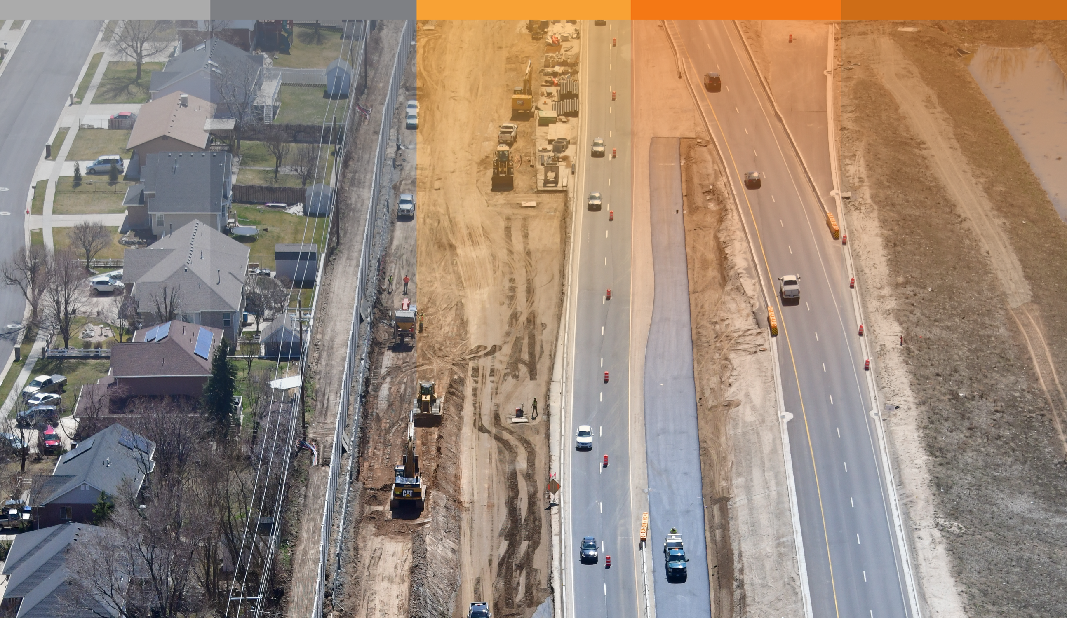

PROGRESSIVE DESIGN-BUILD:
MANAGING RISK AND SCHEDULE FOR COMPLEX PROJECTS

Slide 2
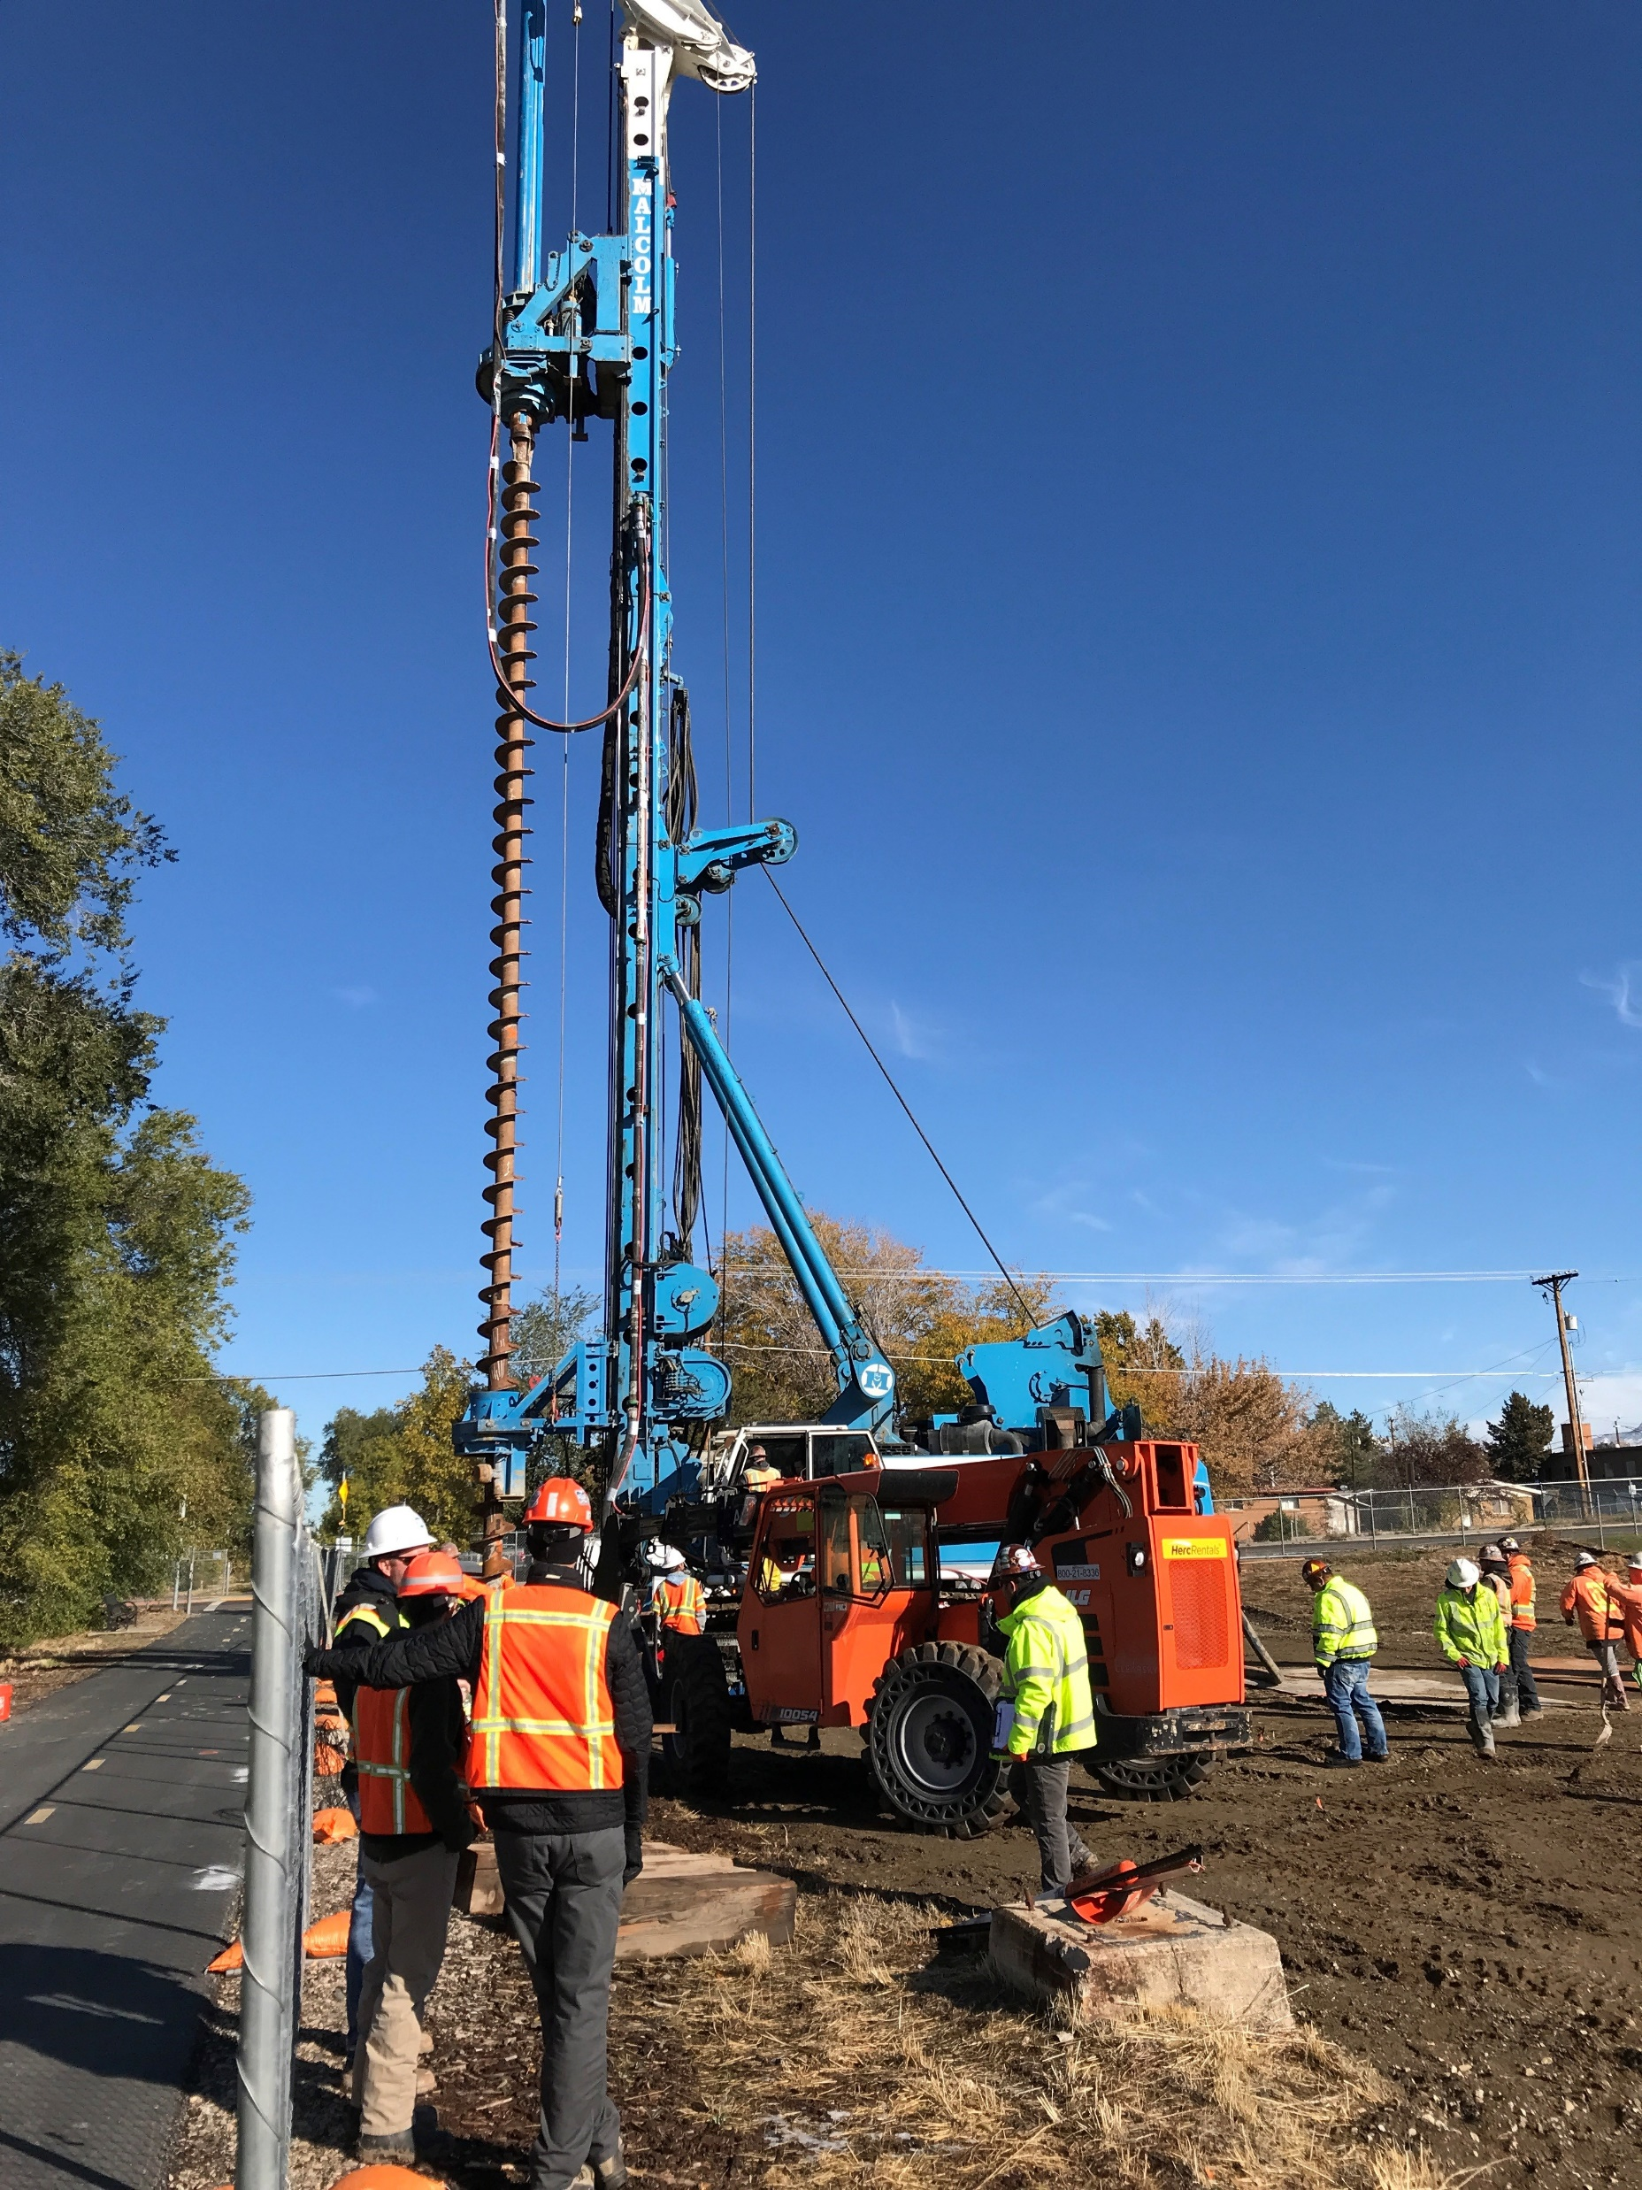
What is Progressive Design-Build (PDB)?
Progressive Design-Build (PDB) is a contracting methods for improving project delivery for construction contracts.
PDB uses a one or two-phased qualification-based selection process, requiring the owner agency and PDB Team to progress the design together, toward a final scope, schedule, and budget.
This method is best used for complex construction projects.

Slide 3
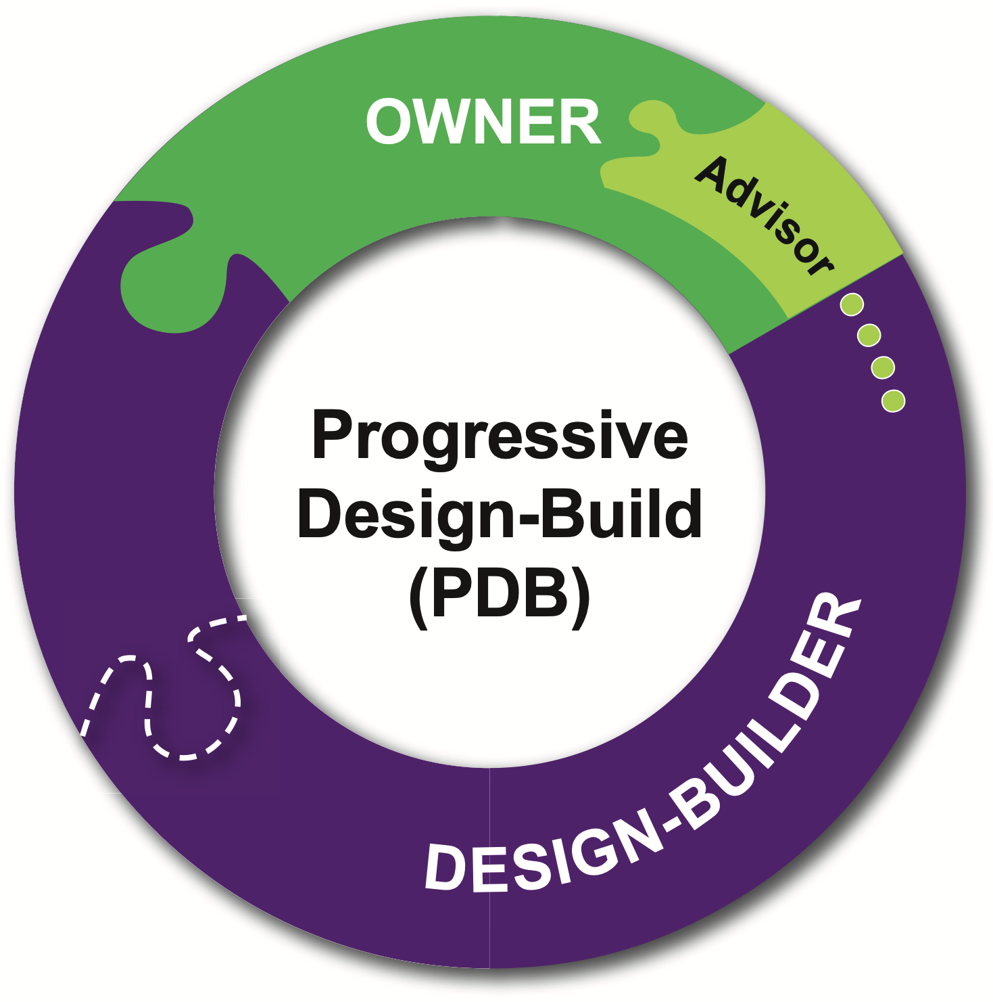


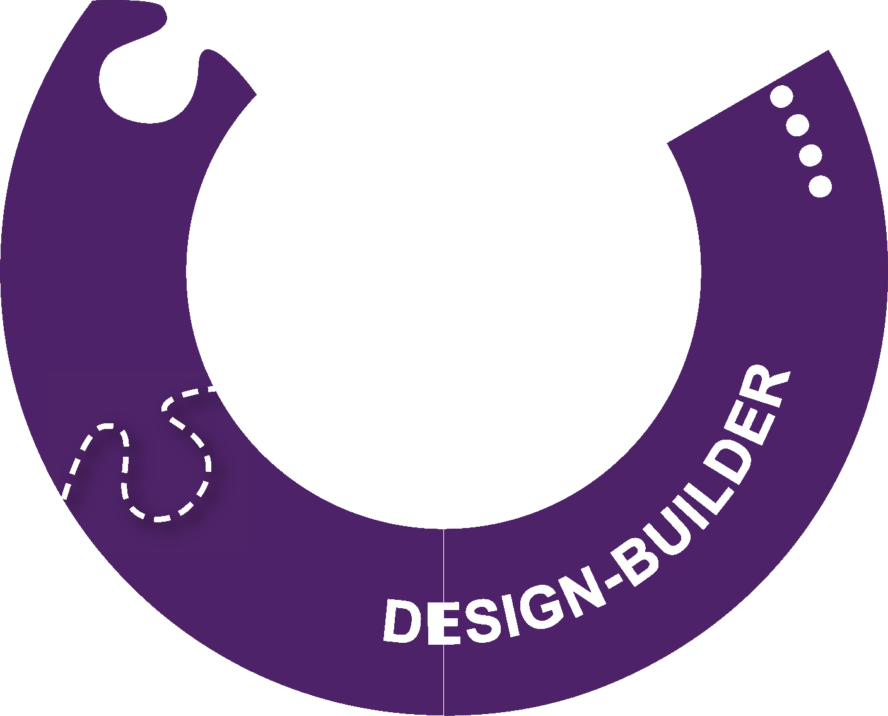

Progressive Design-Build (PDB)
A single entity or purpose-built team to deliver both Design and Construction via a single contract.
Design detail and construction estimate is developed progressively.
Construction starts after mutual agreement on price.
Concurrent activities reduce schedule – construction can start before design is complete
“Design to budget” via design and estimate iteration
GMP, Lump Sum, and Shared Savings options
Notes:
One DB contract with two phases
1st - DB firm works with Owner to develop project scope, detailed design, all permit applications and schedule with “off-ramp” for Owner exclusively if final pricing cannot be agreed upon
2nd - DB proceeds to complete design, construction, testing and acceptance, and close-out
DB has single source responsibility for overall project performance
Phase 1
During Phase 1, the PDB contract is awarded very early in the life of the project, typically before the development of any design elements. Selection is primarily, and often exclusively, based on qualifications.
The scope of work includes budget-level design, preconstruction services, preliminary engineering; and scope, schedule, budget refinement, and negotiations.
Early work packages may be executed as the Phase 1 work and GMP/TMP negotiations progress.
The guaranteed maximum price (GMP)/ targeted maximum price (TMP) negotiations occur at predetermined points in the design process (i.e., 30, 50, 70, 90 percent designs).
Once an agreement is reached, execution of the Phase 2 contract is executed for the agreed upon scope, schedule, and cost, inclusive of any early work packages. If the parties cannot reach agreement on Phase 2 terms, the owner agency may elect to “off-ramp,” similar to the CM/GC process.

Slide 4
ADVANTAGES OF PDB
Highest degree of flexibility to meet the project goals
Scope, schedule, budget, third-party coordination, right-of-way, etc.
Integrated team to support the Owner in the delivery of their vision of the project
Simplified contract management: single point of responsibility
Increased owner control and cost transparency
Improved risk management and allocation
Innovation, quality, and constructability reviews during design
Notes:
In relation to CMAR/DBB/DB…
Limited number of firms willing to do DB right now, vs PDB.

Slide 5
DISADVANTAGES OF PDB
Qualifications based selection of contractor which limits competition during cost estimating.
If collaboration and project team struggles, taking the off-ramp can be challenging.
Notes:
In relation to CMAR/DBB/DB…
Limited number of firms willing to do DB right now, vs PDB.

Slide 6
PDB STRUCTURE
PM / OA
Owner
Design/Builder
Design-Build Contract Development
Design Development & Construction
Phase 1 – Scoping and GMP
Phase 2 – Design-Build
Off Ramp
Finalize Design
Open Bid

Slide 7
PDB INTEGRATED TEAM
Client Project Manager
PDB
Project Manager
Design Quality Manager
Construction Quality Manager
Deputy Project Manager
Safety Manager
Environmental Manager
Design Manager
Design and Constructability Coordinator
Construction Manager
Cost Estimator
Scheduler
Pavement Design
Roadway Design
Structures Design
Railway
Drainage Manager
Structures Manager
Drainage Design
Environmental / Landscaping
MOT Design
Third-party/Utilities
Third-Party/Utilities Manager
Roadway Manager
Traffic Modeling/Analysis
Geotechnical Design
ATMS / Signal / Lighting
ROW Design
Paving Manager
Notes:
Org chart / One POC
Integrated team to support the Owner in the delivery of their vision of the project
Simplified contract management: single point of responsibility
(5600 s. Structure)

Slide 8
PDB VS. OTHER DELIVERY METHODS
PROGRESSIVE DESIGN-BUILD (PDB)
DB Team & Program Management Selection
Design
GMP
GMP
Design-Build
DESIGN-BUILD (DB)
Program Management Selection
Program Management
Preliminary Design and RFP
DB Team Selection
Design-Build
CONSTRUCTION MANAGER AT-RISK (CMAR)
Designer Selection
Design
Build
BID
Contractor Selection
Contractor
DESIGN-BID-BUILD (DBB)
Designer Selection
Design
Contractor Selection
Build
BID
Notes:
Add 1 year for procurement documents
DBB – correct the time frames - Shane
CMAR title edit
OPC at/before 60% and FPC at/before 90%; GMP final

Slide 9
OPEN-BOOK ESTIMATING
Open book estimating helps make informed decisions on cost, schedule, design, scope and quality.
TRANSPARENCY AND VALIDATION
Nothing hidden, embedded or inflated.
ACCURACY AND COMPLETENESS
At a minimum, should include everything required in “Cost of Work” in the Project Agreement.
RISK AND OPPORTUNITY
Not everything is predictable. Need to have a risk management plan backed by a contingency philosophy.
REALISM AND FAIRNESS
Design to budget doesn’t mean fit to budget.

Slide 10
Progressive Design-Build Cost and Price Development Overview
Offers flexibility and Owner input, with final cost determined during design.
Best when Owner wants design input and “design to budget” Design-build model that supports owner control of design, yet shifts performance guarantee to others
Open Book, Fully Transparent Estimate and SpendGu
Design-Change Tracking = Scope Management
Collaborative Budget Decisions Immediate Estimate Revision
Provides price certainty at mid- to late stage of design GMP determined at 60+% design; “off-ramp” provided if GMP agreement not reached
Market-Based Pricing (Bid the Work)
Garanteed Maximum Price =
Underrun to Owner/Overrun to Contractor
No Change Orders (Except by Owner)
0% -30% Design
60% Design/GMP
100% Design
Owner’s Budget
Contingency
GMP
Estimate
Proposal
Detailed Design
Construction
Award

Slide 11
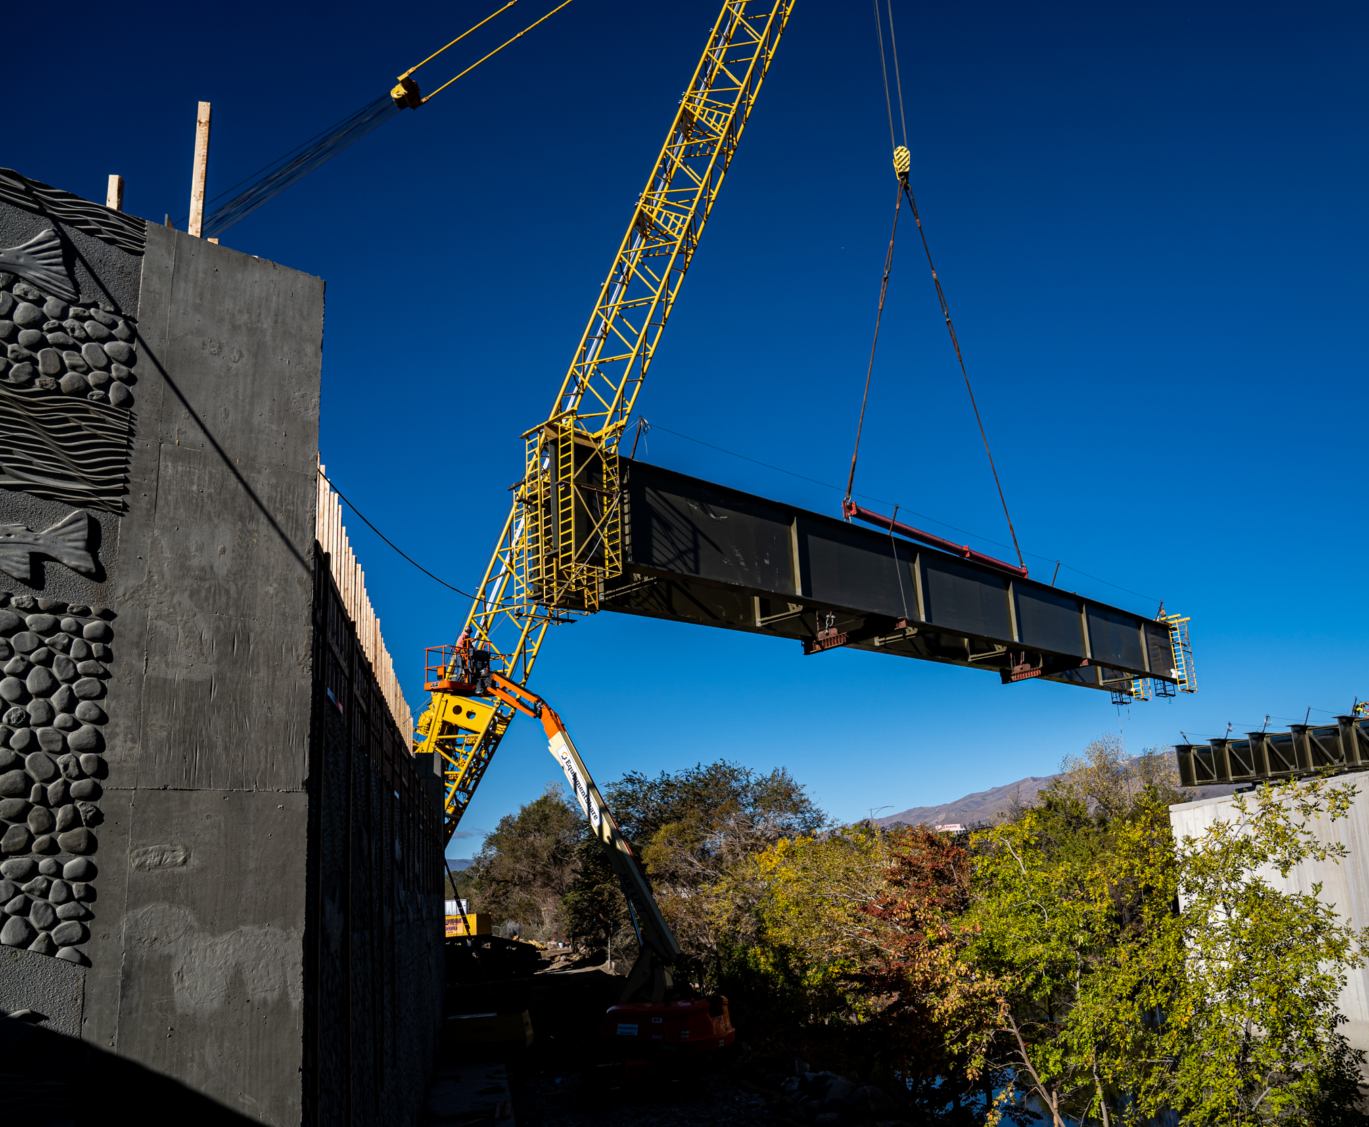
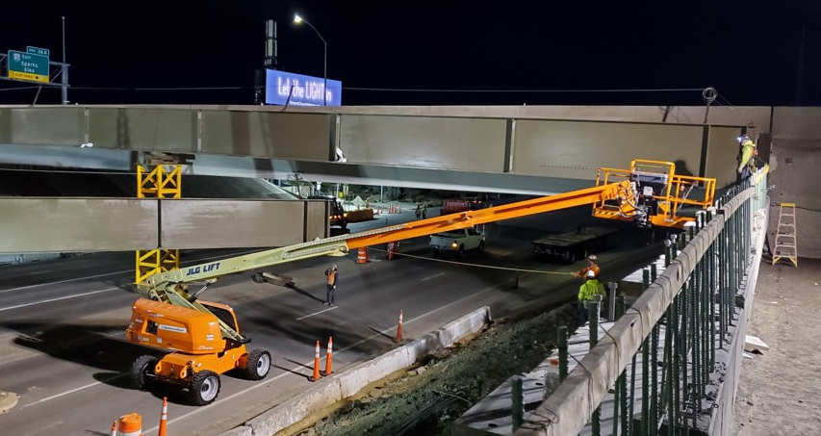
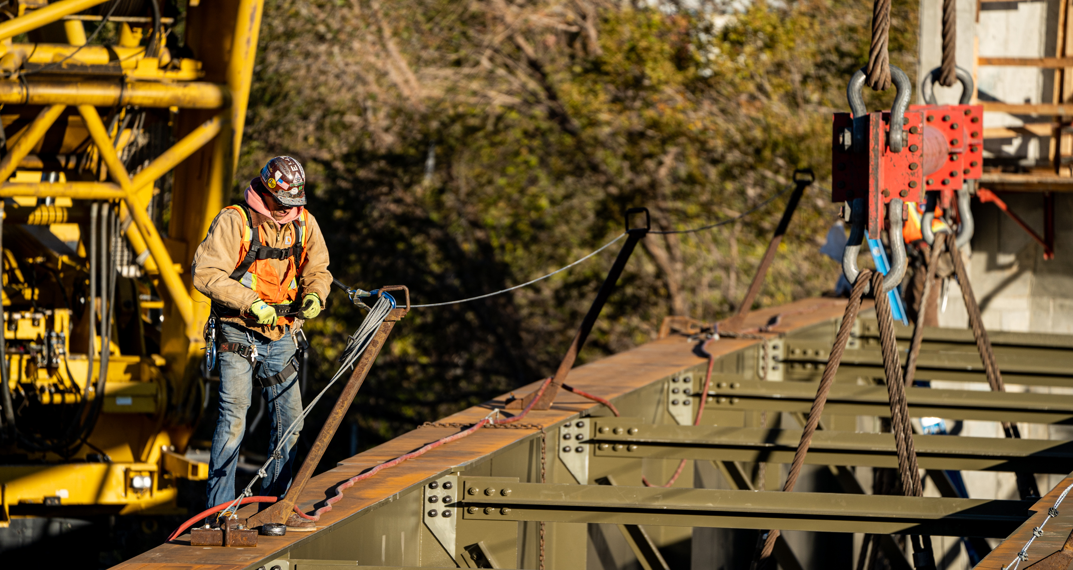
PDB REFINES SCOPE
PDB: In Progressive Phase
DB: Prior to selection
Community input
Stakeholder needs
Reduces utility impacts
Partnering
Finalize design criteria
Determine footprint
Utilities are reactionary
Owner input closes
vs.

Slide 12
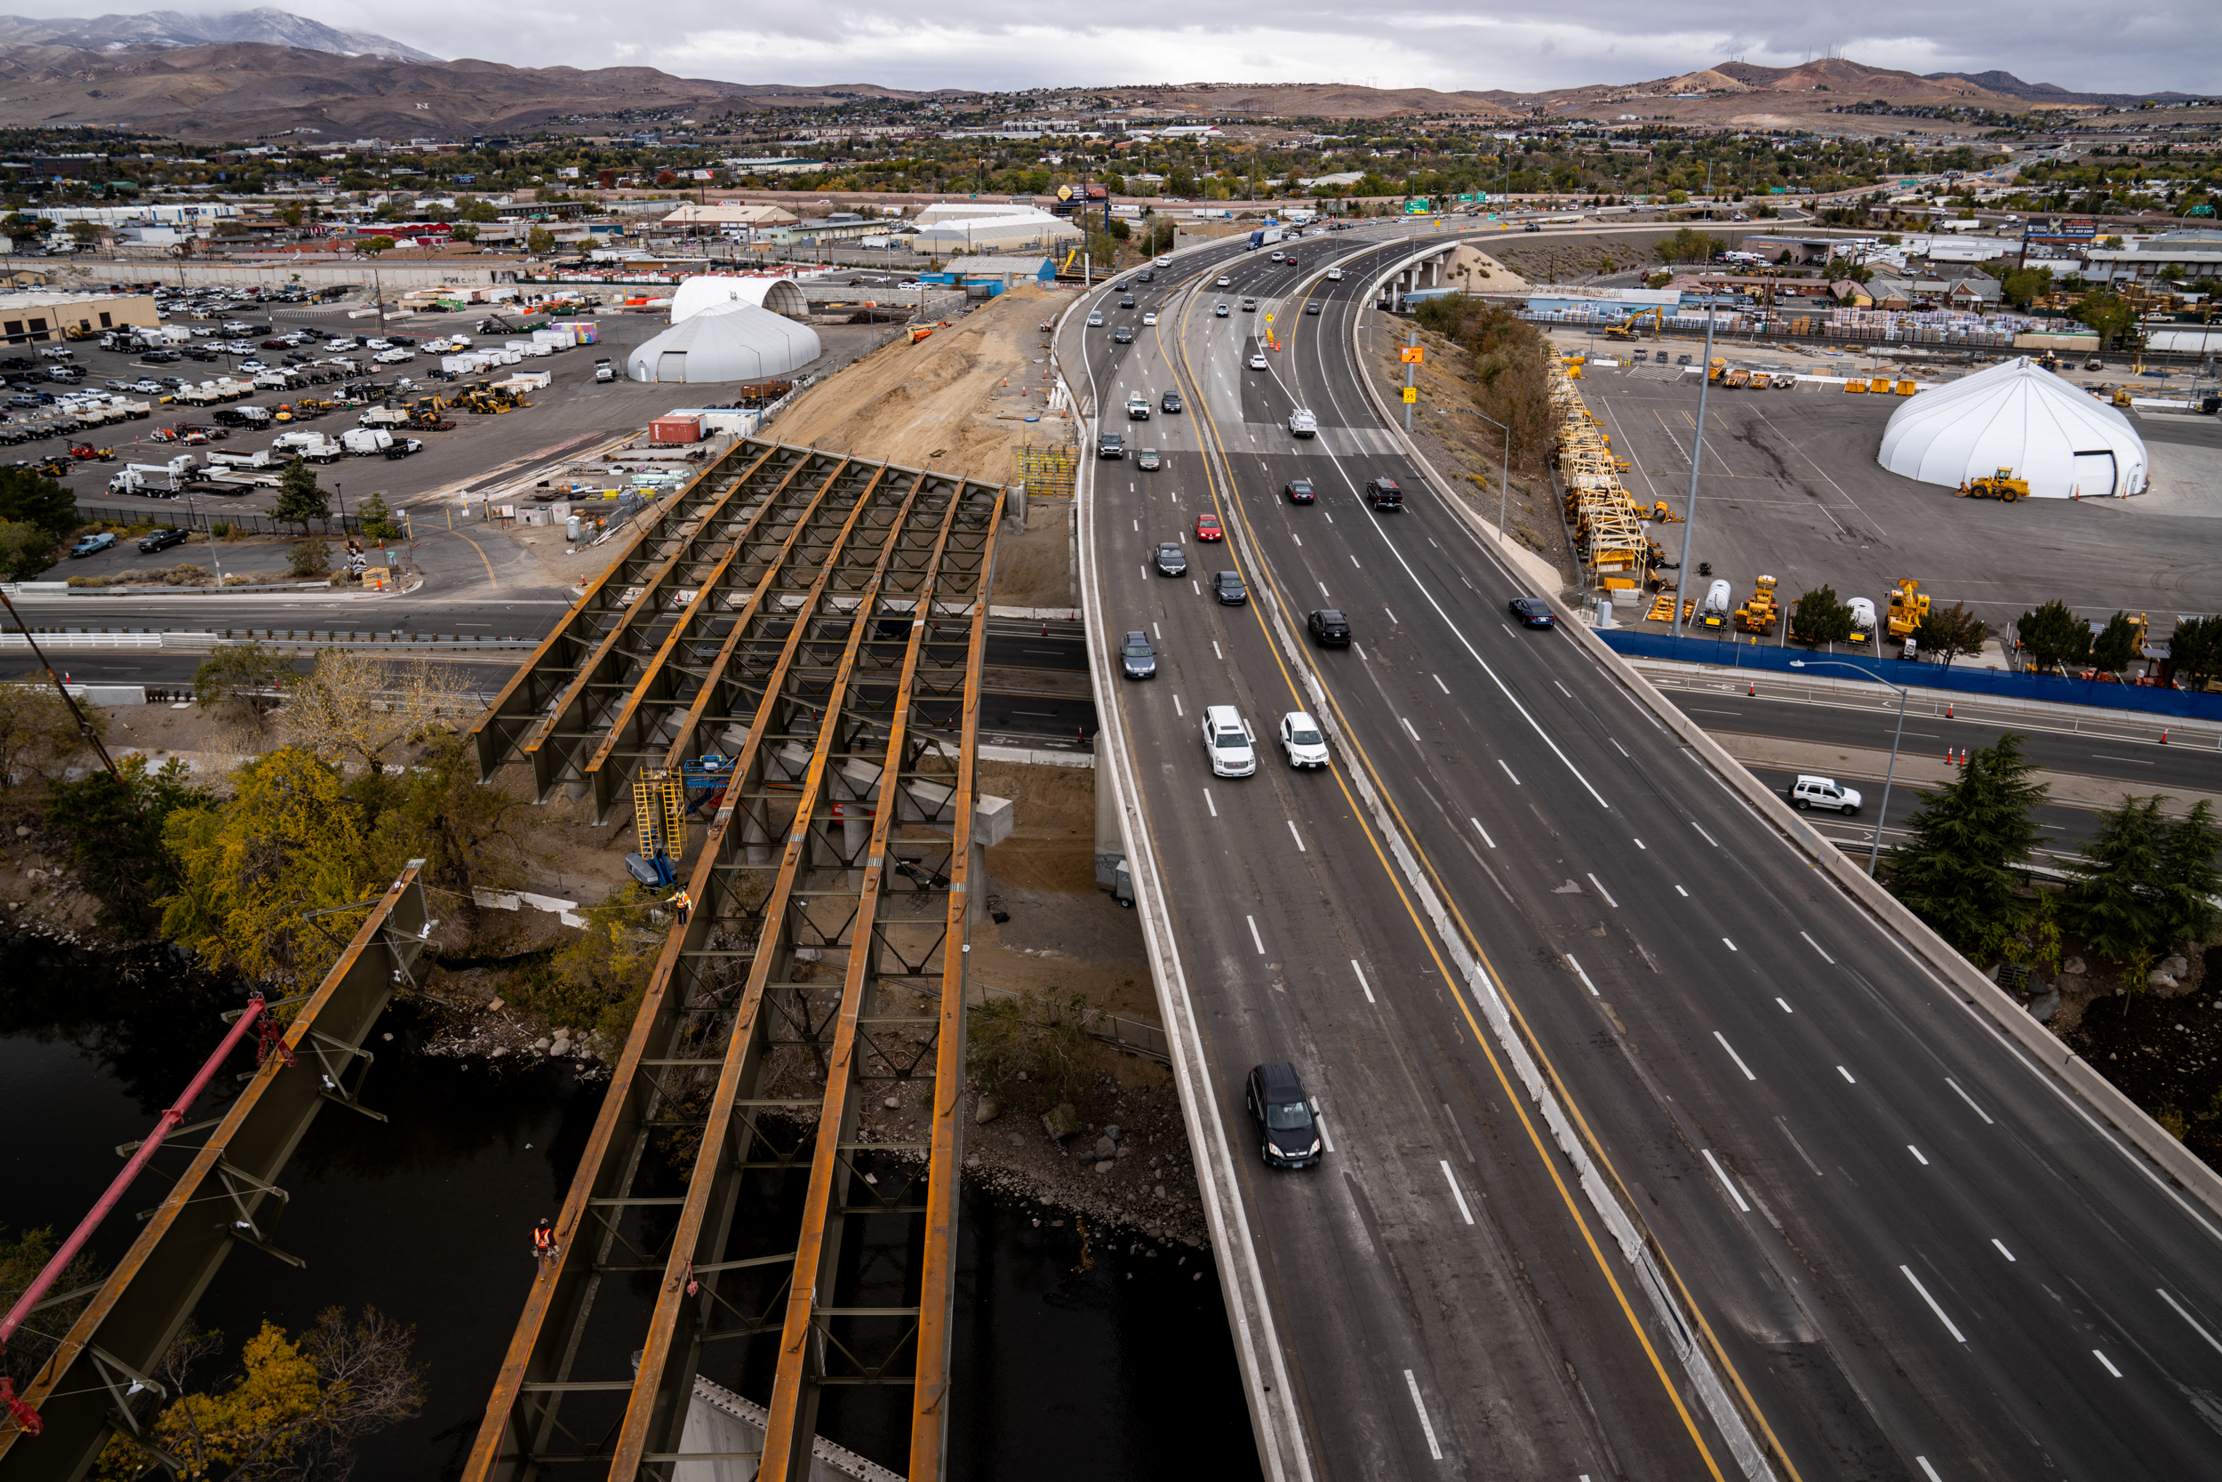
PDB REFINES COST
National average within 1% of D-B
Multiple Contractor Driven Estimates – increased accuracy
Open Book Process – greater transparency
Design-Bid-Build is an Option – if a fair price cannot be negotiated
Opportunity for Savings Provides an Incentive for CM:
Control costs
Work within funding limits
Notes:
Owner is in ultimate control of the scope
Owner can drive cost significantly through wants, need a good project manager from the department to control cost

Slide 13
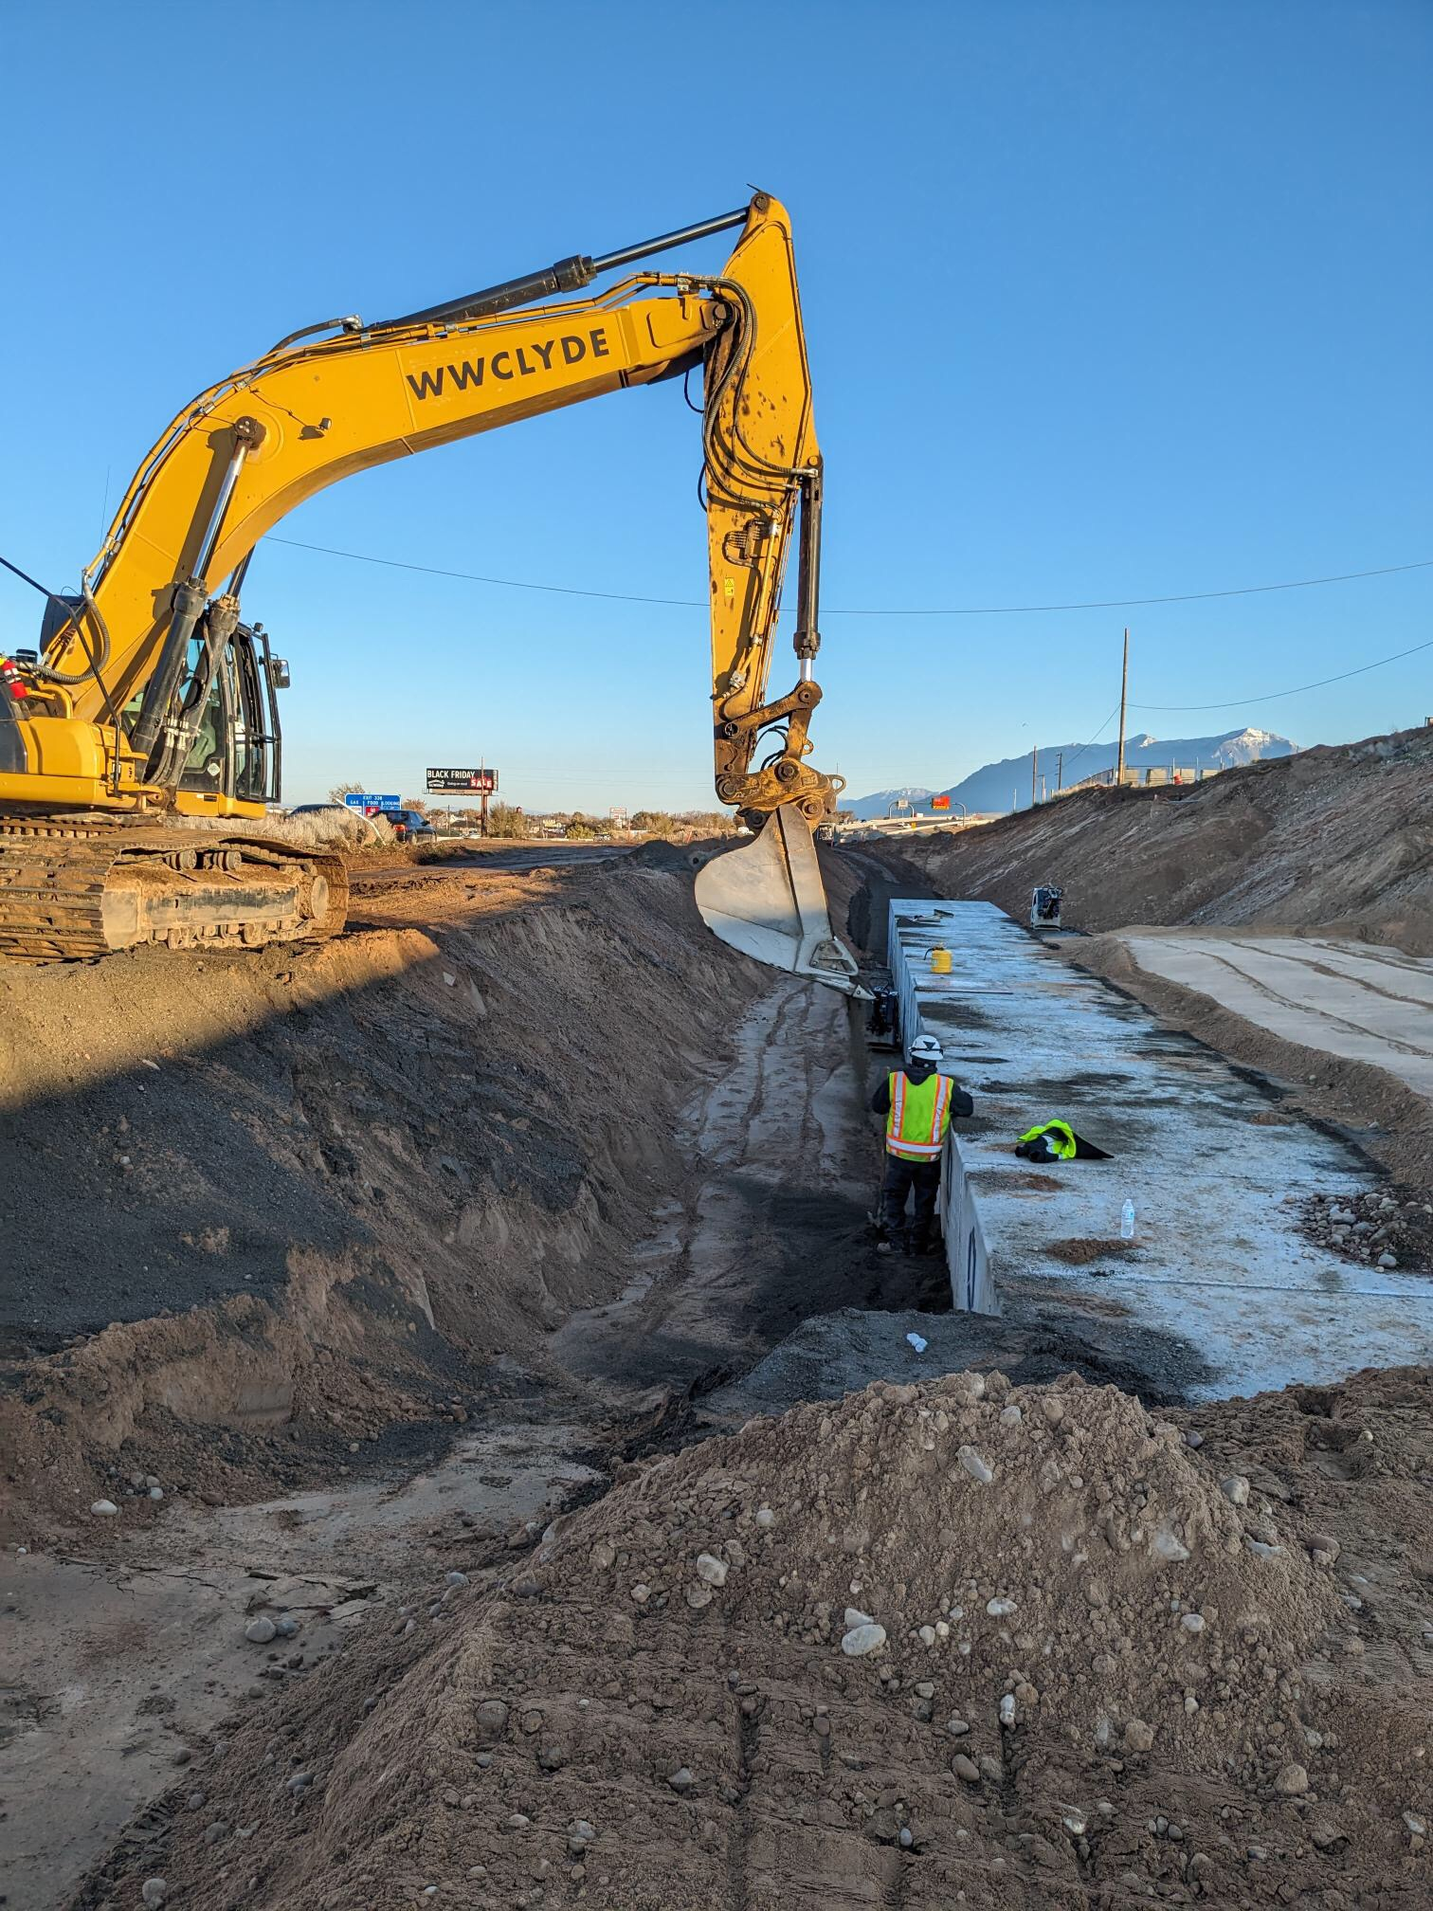
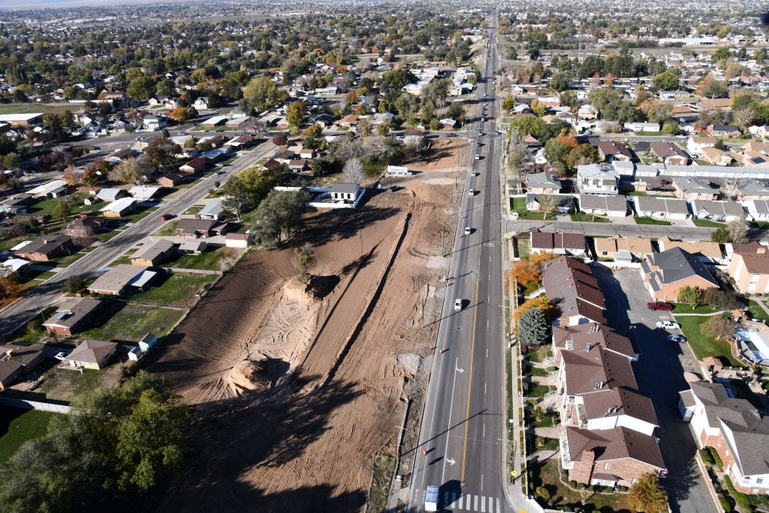
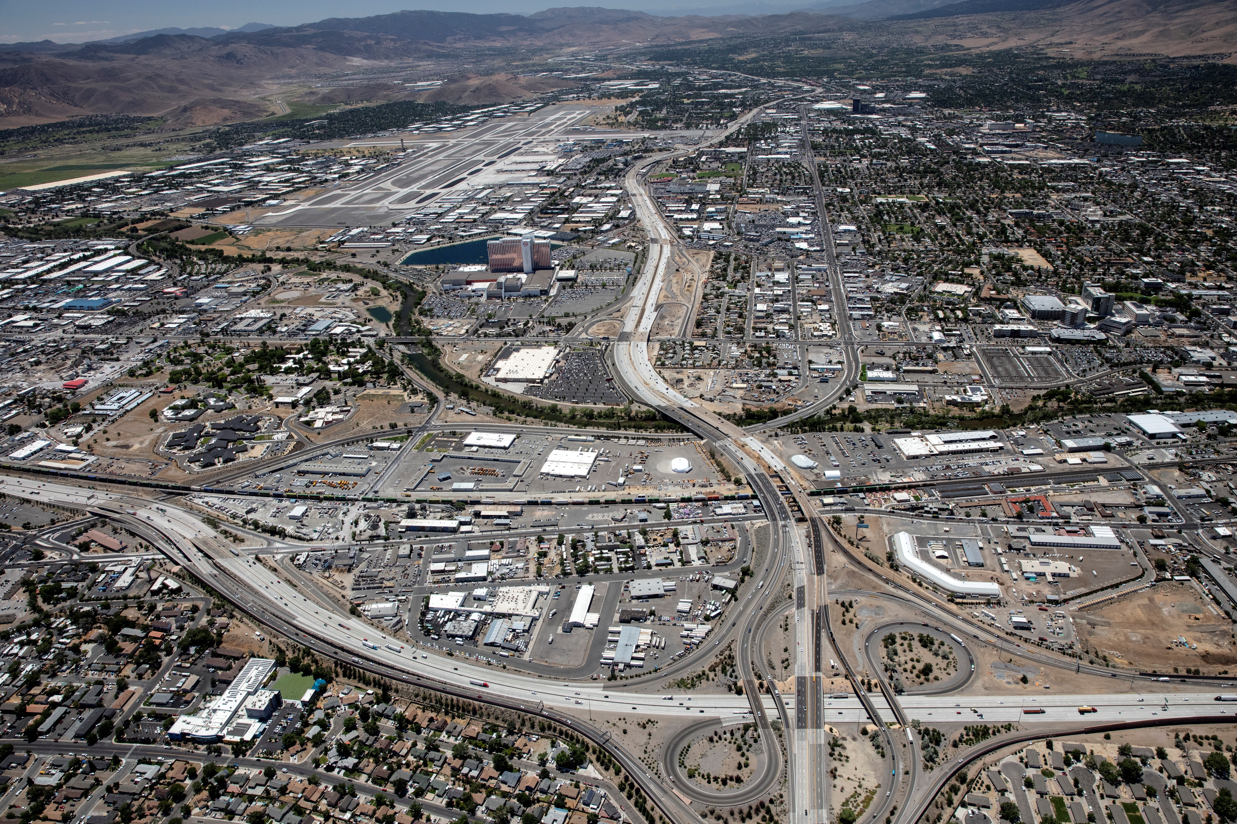
PDB RISK MANAGEMENT
Integrated team approach
Risk evaluation
Risk allocation
Provisional items
Open-book estimating
Risk owner
Notes:
An integrated team approach to risk provides greater understanding of each risk and provides the owner with better information to make decisions.
The team identifies, discusses, and mitigates risks as part of the preconstruction phase.
Prior to the final estimate and GMP, unmitigated risks are assigned to the design-builder or the owner.
Provisional items allow the owner to benefit financially by removing risk for unknown conditions that are typically bid such as subgrade stabilization, pothole patching, etc. from the GMP.
Open-book estimating is used to demonstrate how risk is accounted for in the project pricing.
Risk allocation
Price certainty with risk allocation from owner
PDB: In Progressive Phase
Risk in contingency
Bid at 60% and 90%
to contractor
DB: Prior to Selection
Bid risk
Bid at 30% and 60%

Slide 14
THIRD-PARTY COORDINATION
Progressive Design-Build
Design-Build
Streamlined coordination with third-parties
Early coordination allows for ordering long-lead items (steel poles, etc.)
Integrated and aligned with the project approach
Upfront work and draft agreements based on the Owner’s concept
Third-party impacts are based on assumed construction phasing
Limits innovation in the design, construction, and scheduling related to third-party facilities
Limits or restricts DB team’s ability to contact or coordinate with third-parties until after DB team selection
vs.
PDB ALLOWS FULL ENGAGEMENT FOR UTILITY COORDINATION DURING DESIGN

Slide 15



















US-89 PDB
Project overview and how PDB was applied to the project
Notes:
Mike R.
Thanks from the team
Q&A

Slide 16
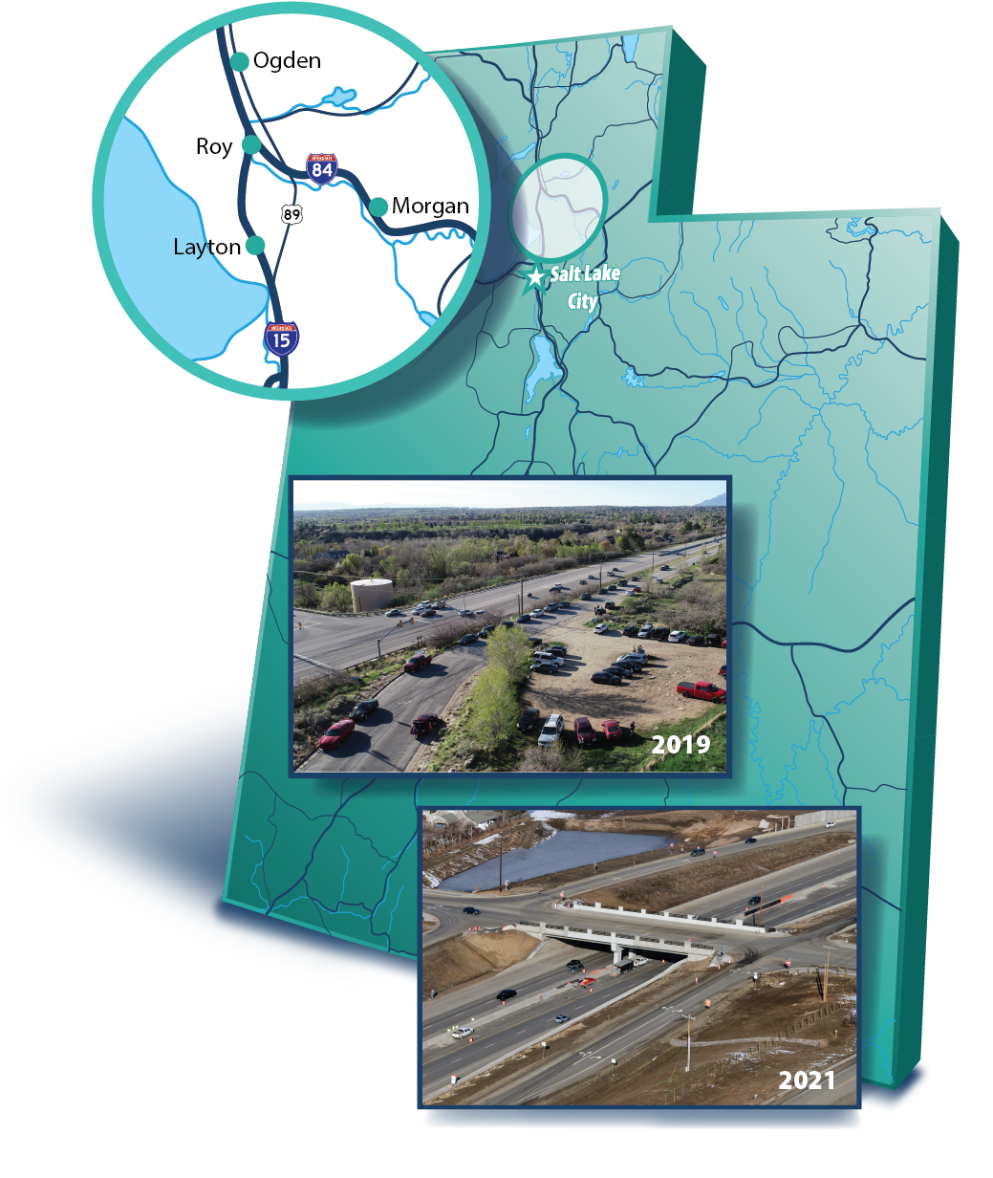
What is the Project?
9.7 miles of improvements
4 new interchanges
2 new grade-separated crossings
New surface street connections to the interchanges
Additional travel lane in each direction
$650M ($365M Construction)
Notes:
roject update: where are we now in construction
Overview of the project

Slide 17
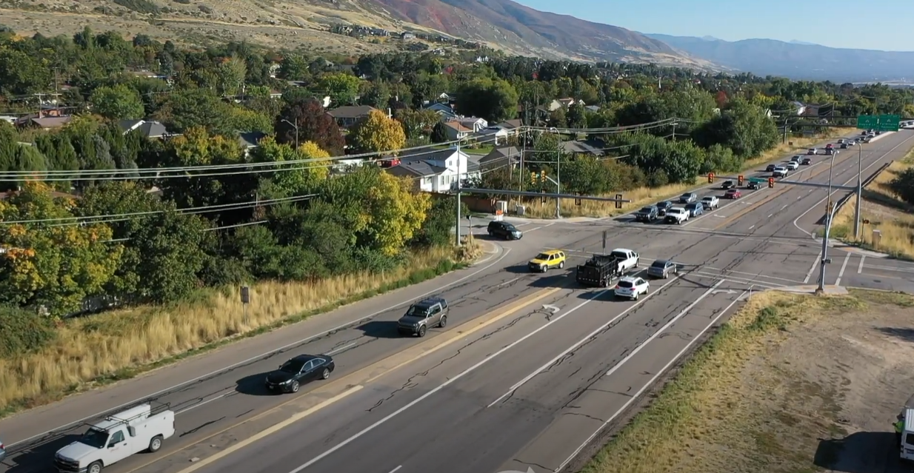
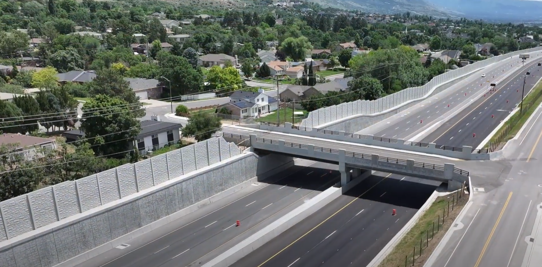
US-89; FARMINGTON TO I-84
BEFORE
AFTER
Search for “US-89 Davis County Before & After” on the UDOT YouTube channel

Slide 18
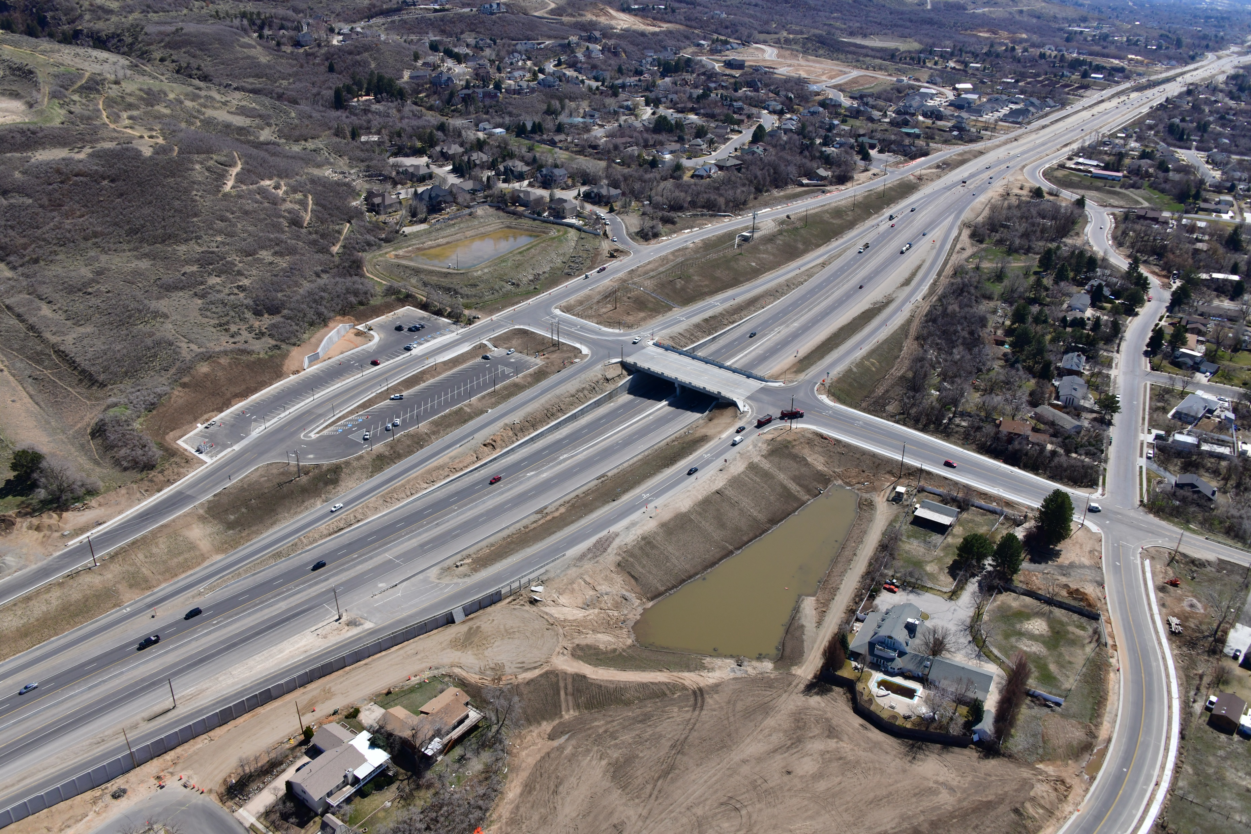
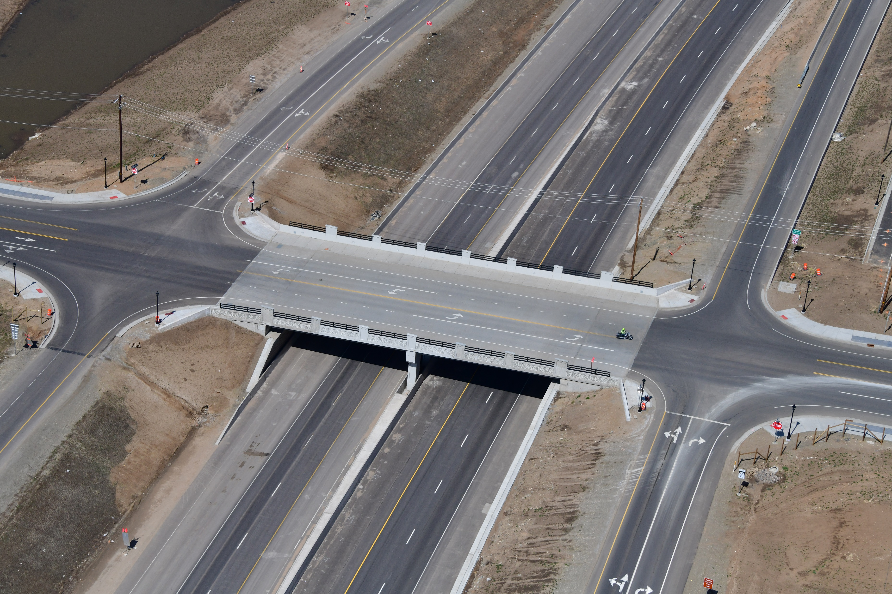
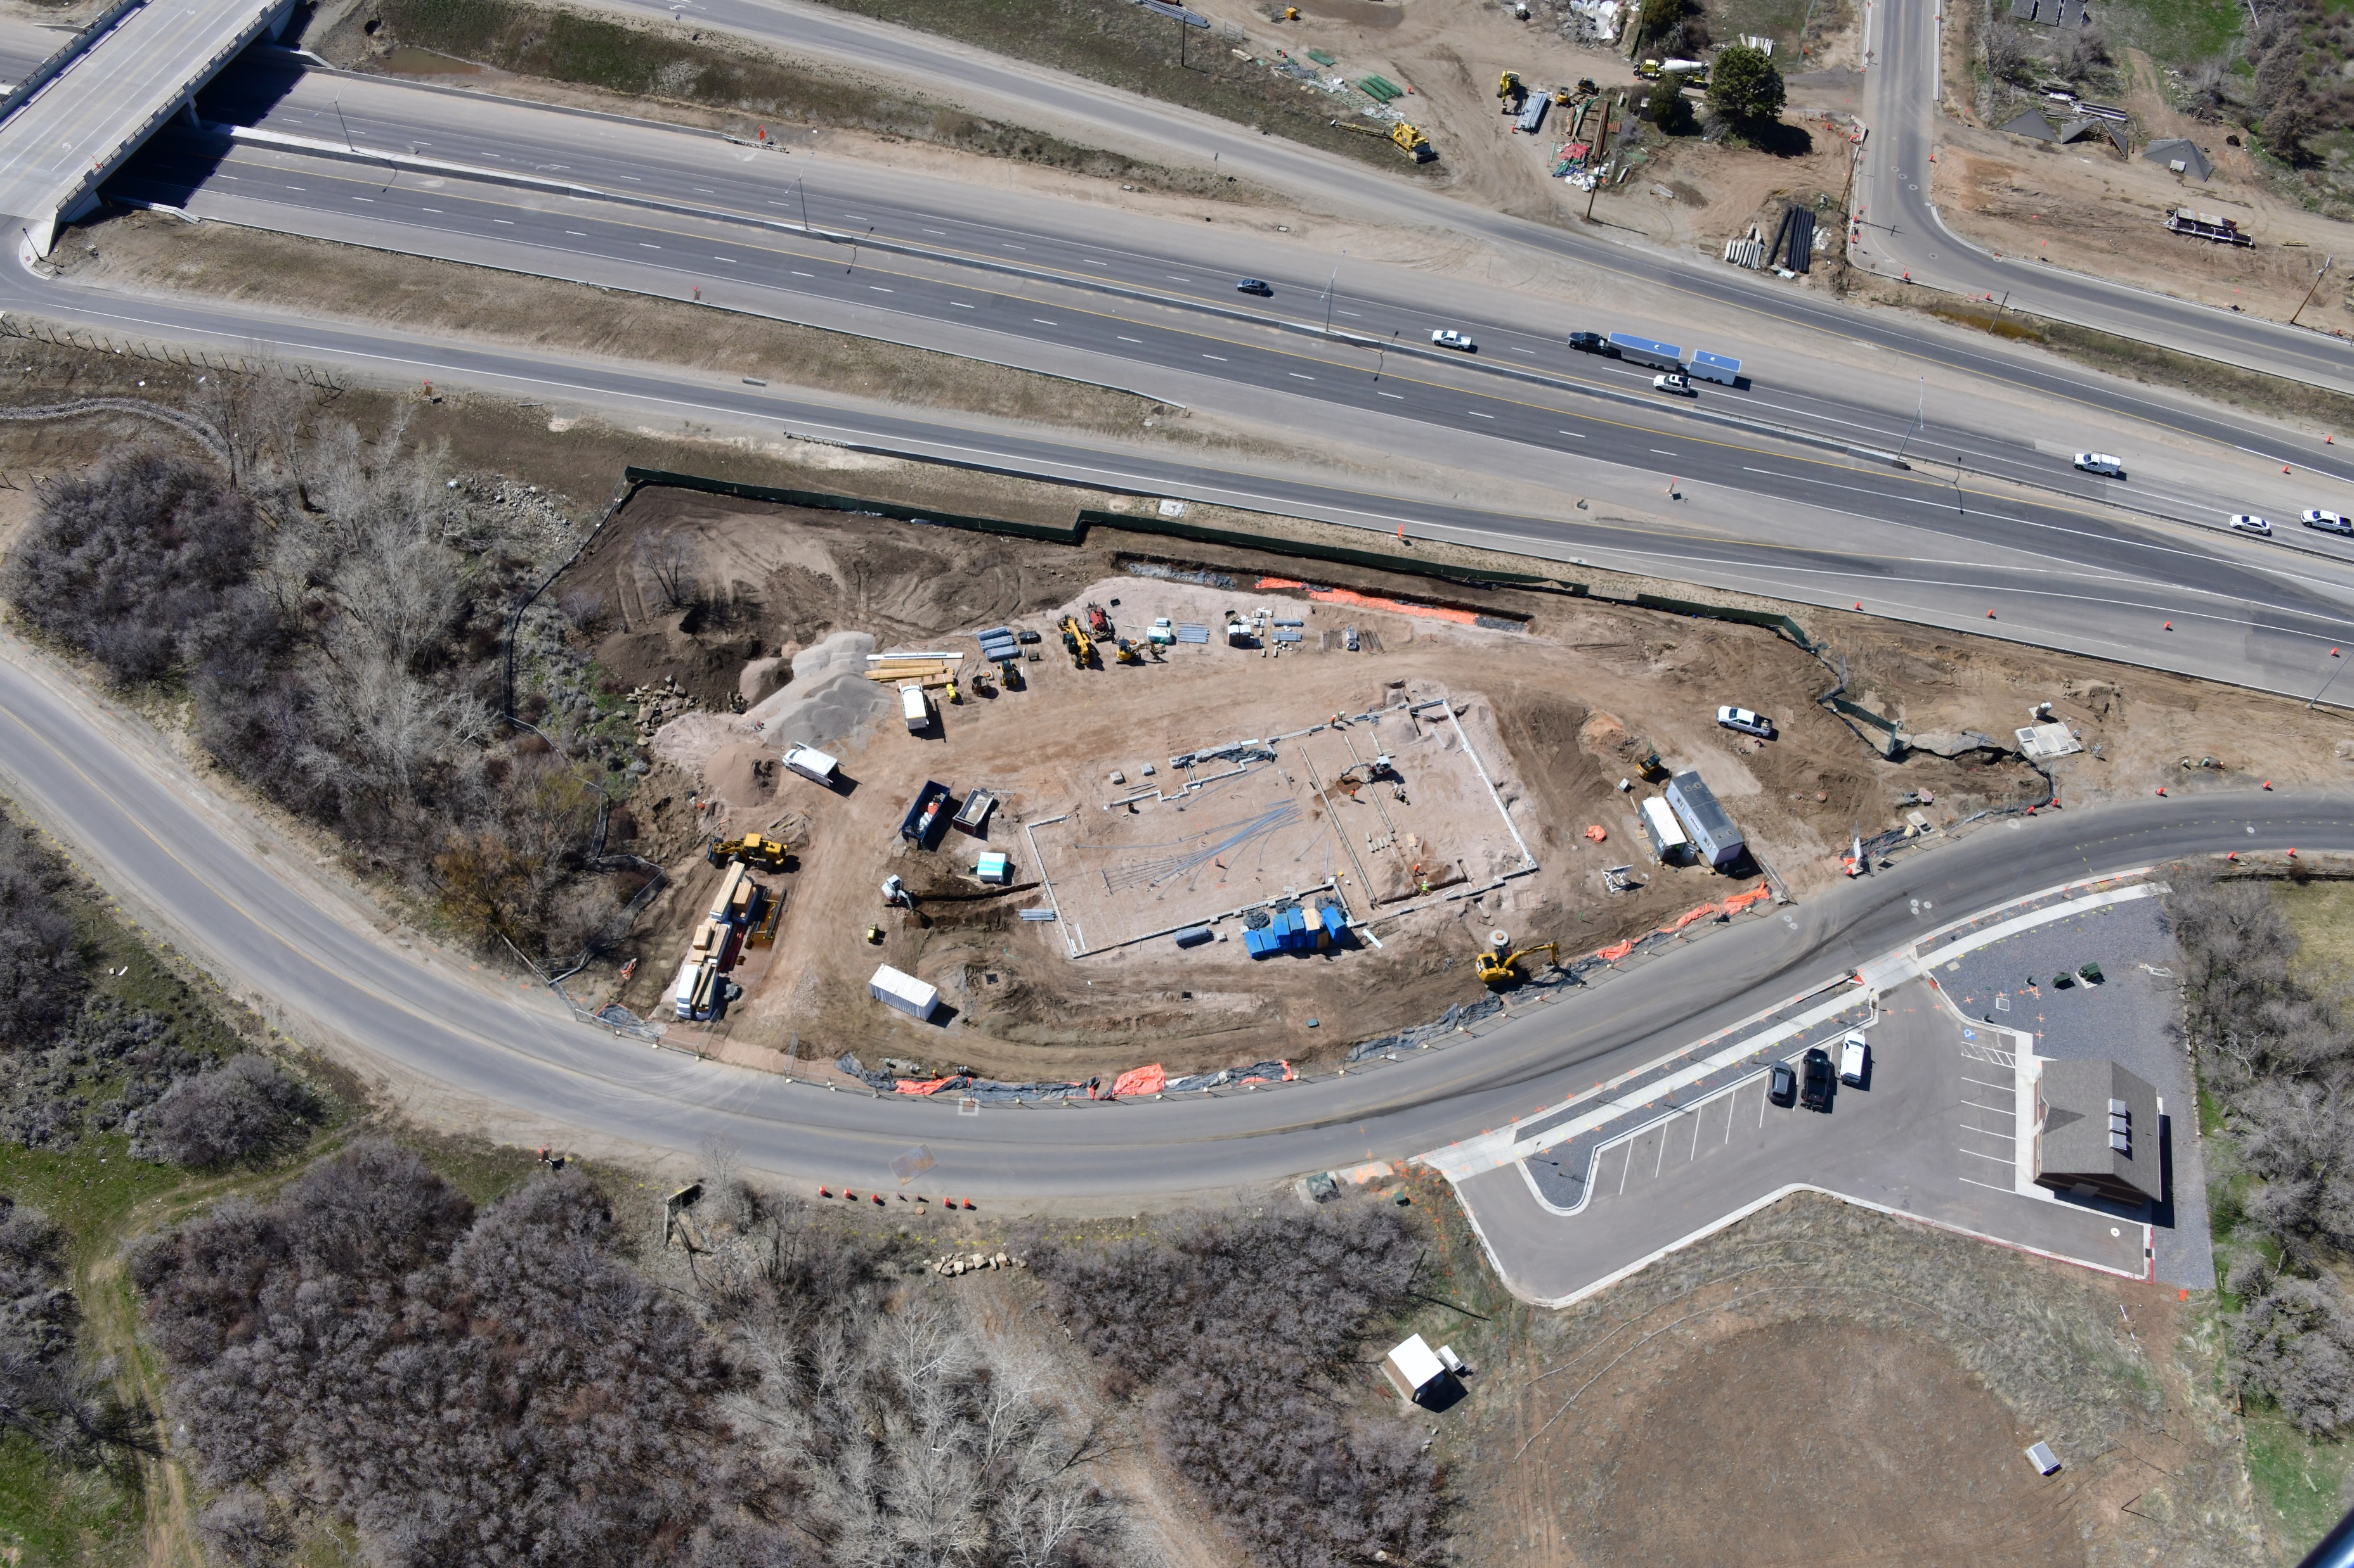
US-89; FARMINGTON TO I-84

Slide 19
Why was PDB used?
Opportunity (Right Scope): Tailoring the project to community preferences and third-party needs
Optimization (Right Schedule): Constructability and schedule efficiencies integrated from the outset
Flexible (Right Budget): An owner-controlled, contractor-involved scoping process infused with innovation
Notes:
Set up to all of this was a lawsuit and public concerns of how the project would fit in the communities along the corridor
UDOT evaluated different delivery methods considering this community concern
PDB gave UDOT control in the design (similar to CMGC) with direct contractor input to mitigate risk and help respond to the community’s questions
Three bullets on slide are the advantages realized

Slide 20
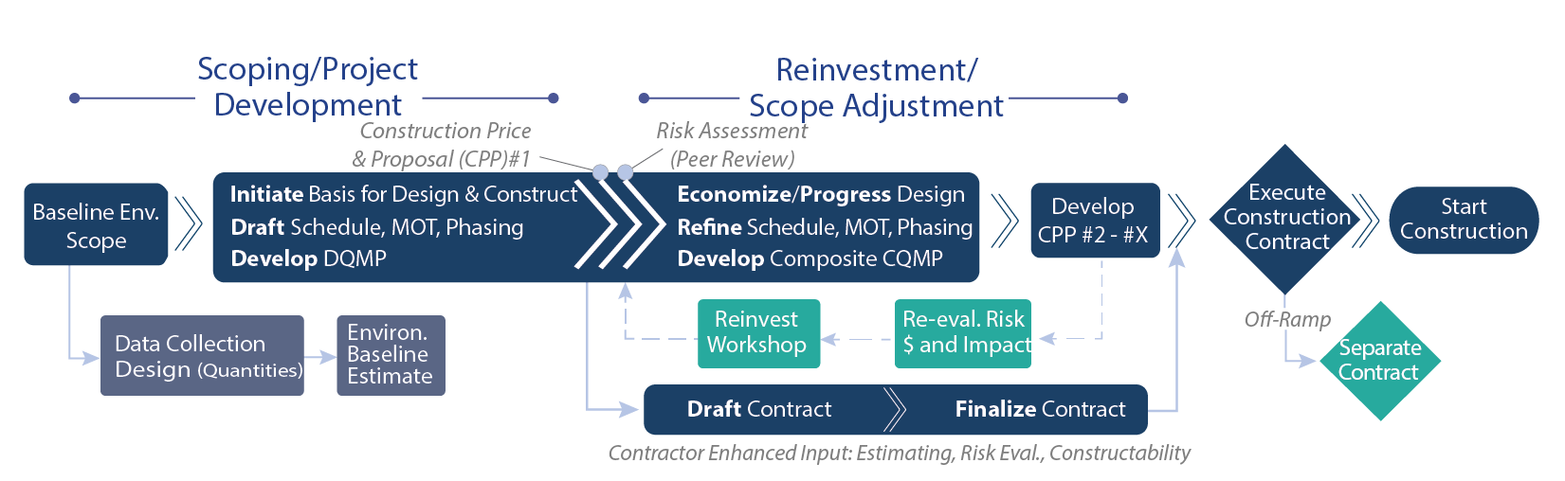
US-89 PDB Process
Notes:
Focus on two phase approach (top line of the graphic)
Team reviewed the Env. baseline design and cost and noticed pricing/budget concerns ($100M deficit)
Turned to the PDB Team to collaboratively determine what a reasonable project scope is
Then transitioned to design refinements/optimization (Phase 2) to drive/refine ideas and concepts to meet budget expectations

Slide 21
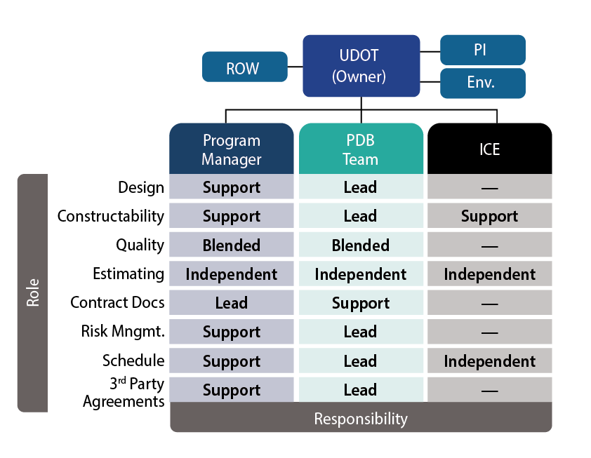
US-89 PDB Organization
Contractor input during the scoping phase
A collaborative owner-contractor relationship
Program Manager extension of UDOT
ICE to validate pricing
Notes:
On this project, roles are similar to DB and CMAR, but responsibilities are different (see org chart)
PDB team led in technical design and constructability/construction input
Supported the Owner and Program Manager in developing the Contract
Program Manager led contract development, and supported throughout in design, constructability, etc.
All estimating was independent
With blending in the quality (more to come on this)

Slide 22
Maximizing Project Value
Promoting timely owner decision-making and early contractor engagement to finalize scope, drive innovation, and expedite schedule
Notes:
Brian A.
Transition from project and team to how that team looked to maximize value

Slide 23
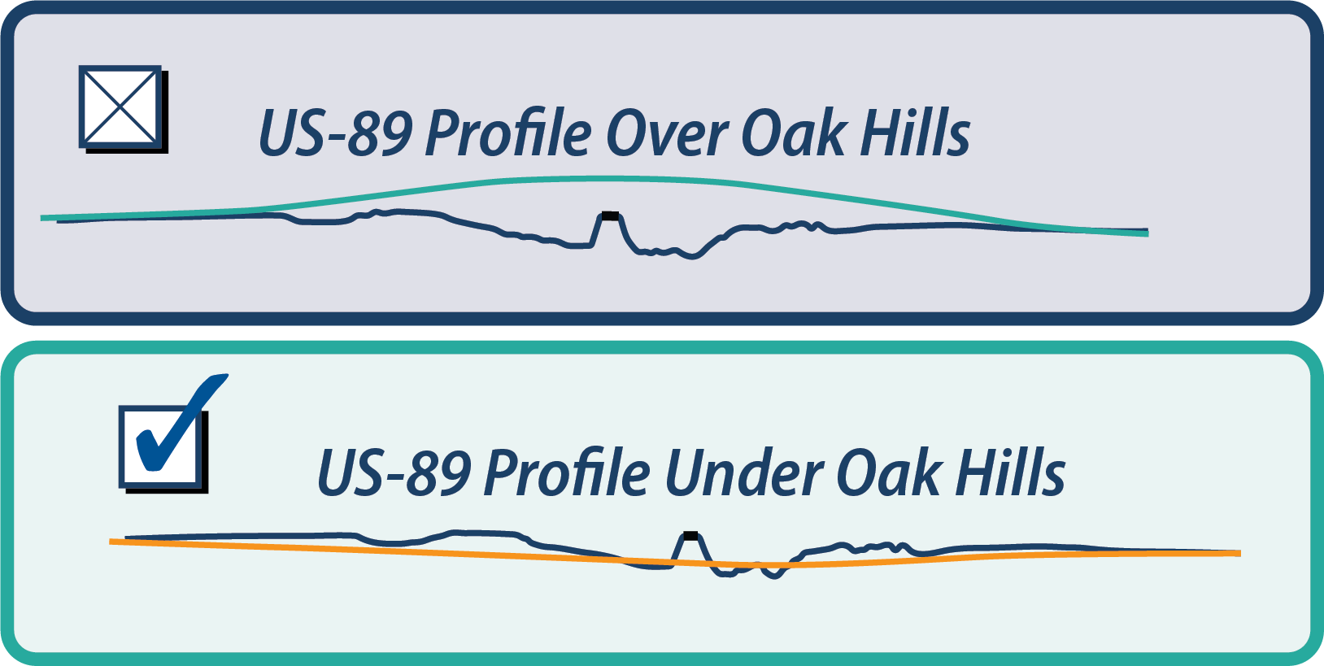
Right Scope
Providing the community options
Getting the project right before scope set
Informed decision making
Notes:
Designers consider every option when designing, but what is best for the project
Team (including contractor) looked at the project as a whole to make over/under decision
May have not have been max. value interchange to interchange, but when you account for hauling and materials, the under profile made the most sense
With the contractor on-board, the owner could make informed decisions that drove ultimate value

Slide 24
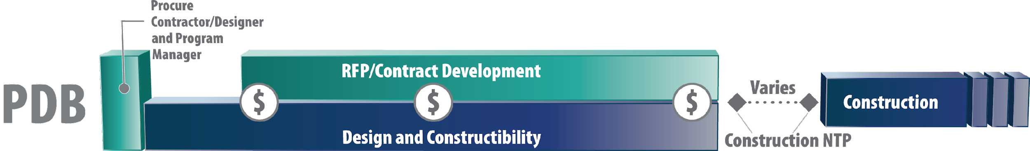
Right Schedule
Design and contract phase overlap led to early construction NTP
Collaborative MOT strategy integrated into the schedule
Longer construction schedule offset by benefit of early, free-flow traffic throughout the project limits
Notes:
Considering schedule, the Owner and PDB team controlled the schedule and go shift slow or fast as ROW and utilities came on line (at times too fast?)
The team was also able to eliminate the # of contracts and duplicity in services through the process
A conservative estimate: process saved 1 year from NTP to the PDB team in pre-con to construction NTP compared to a typical DB and CMGC process

Slide 25
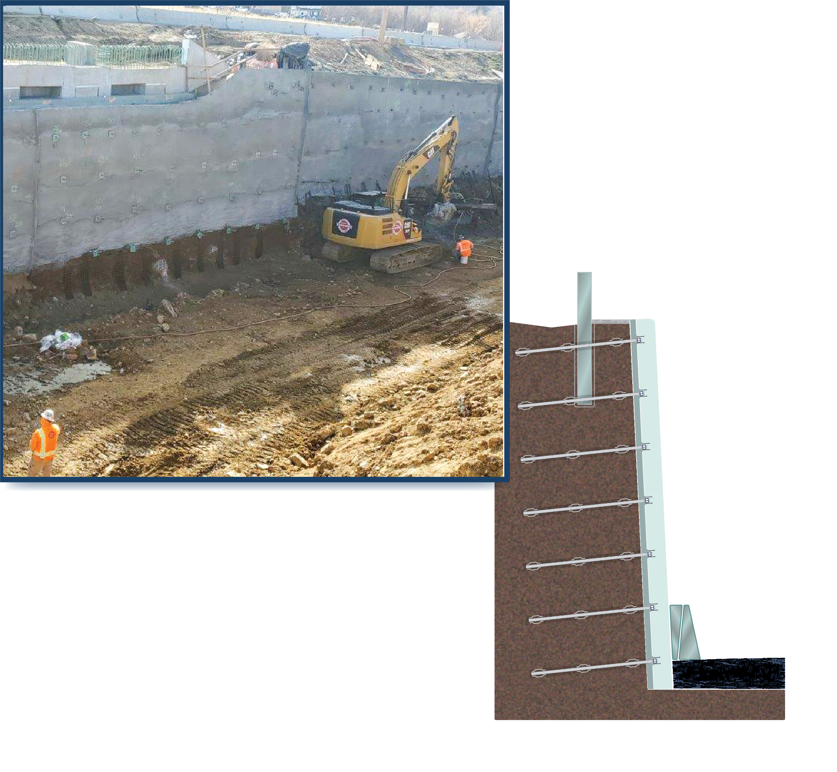
Right Budget
Ideas generated from any team member
Interactive discussion & open dialogue
Unconstrained exploration of innovation
Time for concepts to incubate
Ground Anchor Wall Risk Mitigation
Notes:
In discussing innovation, the team generated a number of Progressive Technical Concepts (PCEs)
All team members contributed; 100% owner savings in the pre-construction phase
This helped the team implement ideas to maximize value, while drive cost down to fit the budget

Slide 26
Arriving at a Fair & Reasonable Price
Lessons learned and best practices to determine a fair and reasonable price
Notes:
Transition from establishing the right budget to arriving at a fair and reasonable price

Slide 27
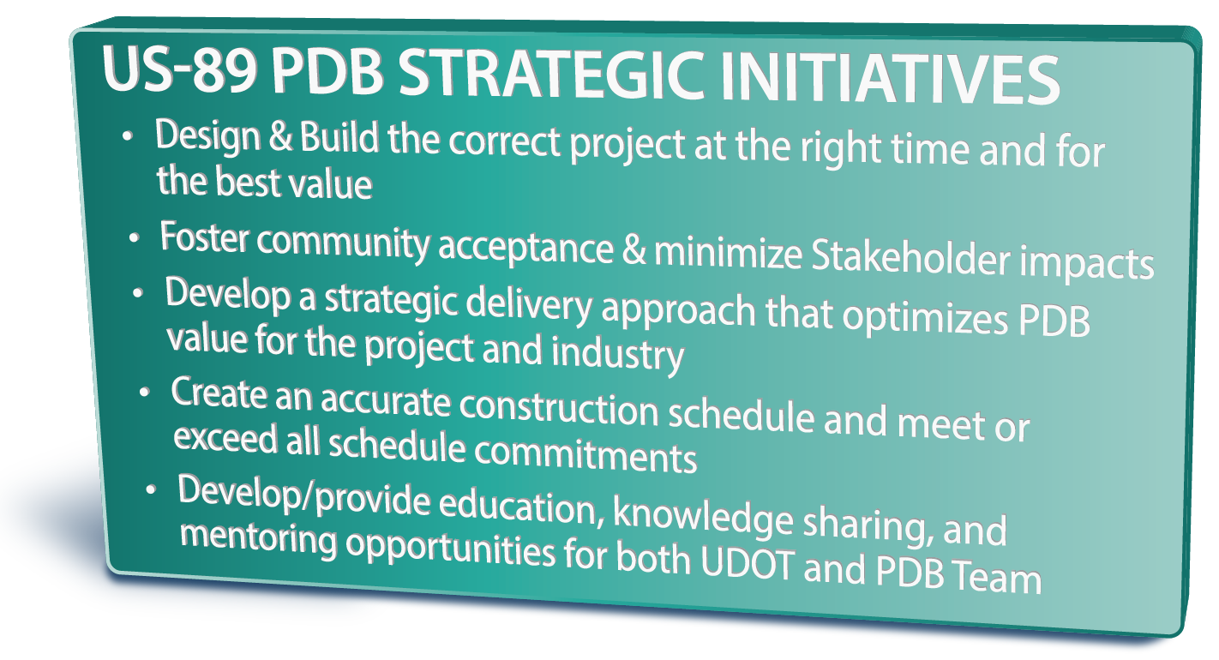
Team Alignment
Developed various estimate “toolboxes”
Co-located as a project team
Administered a robust and transparent RFI process
Notes:
It began with team alignment around the goals of the project.
From the outset of selection, UDOT set project goals and culture intent for the project
Worked to define process, advance goals now specific to needs of the project, and define accountability to track and resolve actions (JSOP)
Used toolboxes for common understanding and co-location for enhanced, real-time collaboration

Slide 28
Stop & Plot, but Continue Design
Design ran parallel with the estimate, saving 6 weeks of design “dead time”
Tracked design changes while estimate progressed
Balanced multiple schedules and design options
Mitigated delays in pricing validation
Notes:
At each milestone (30,60) the current design would be plotted and handed over to the 3 estimating teams.
Typically (in CMGC) the designers would stop for 3 to 6 weeks while the estimate was happening
This team elected to keep the 100 or so design staff moving during that time.
It seems simple in concept, but complicated to track changes occurring in those 6 weeks (what did the estimators need vs. what can be looped into the next design package)
Saved time, was a great idea, and maximized design efficiency, but the challenge was keep track of the changes

Slide 29
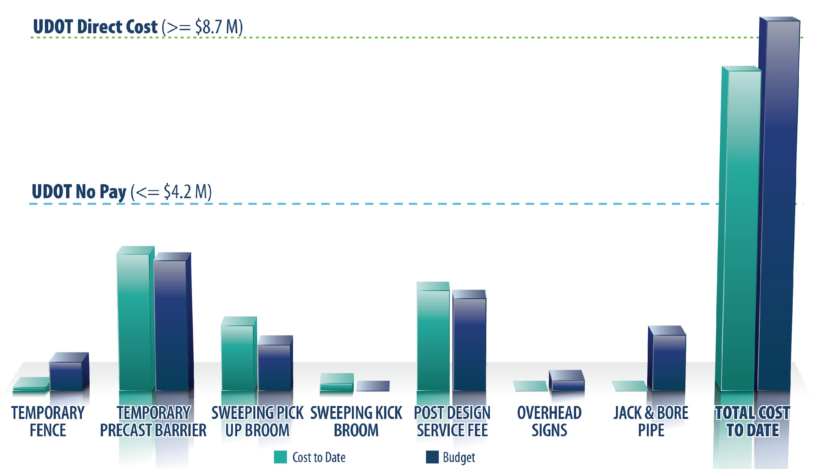
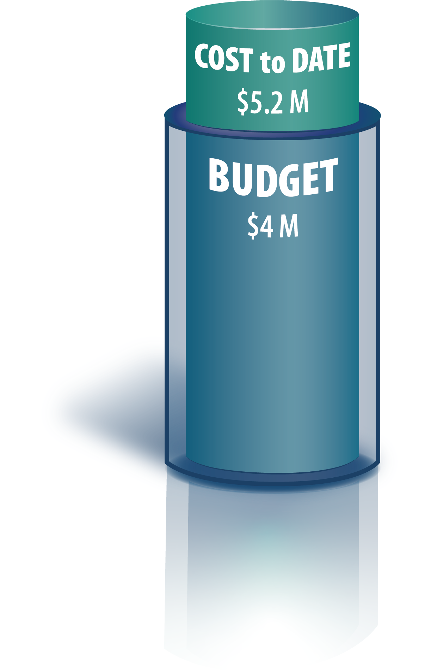
Provisional Sums & Shared Risk
Shared Risk Items
Provisional Sums
Notes:
A majority of the PDB contract is lump sum, but at 60 design there are still unknowns
Instead of waiting to iron all of this out, UDOT and PDB team applied different pricing methodologies (provisionals, shared risk, unit price) to supplement the lump sum approach
This allowed for the pricing to move forward, but still an equitable way to pay
Story on the temp. pre-cast barrier

Slide 30
Tailoring Risk Allocation & Customizing Contract Terms
Mitigating third-party constraints, overcoming budget shortfalls, and transferring risk to those best positioned to resolve
Notes:
Transition from pricing to risk allocation and customizing the contract for the needs of the project: two perspectives on this…

Slide 31
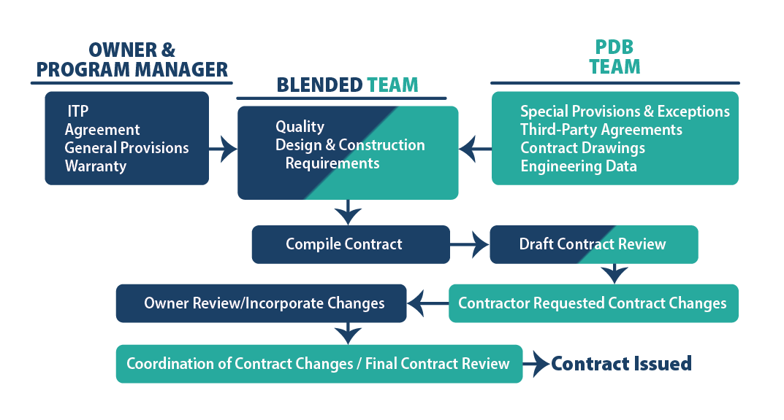
Developing Technical Provisions
PDB: Contractor helping to develop the provisions
Vs.
DB: Owner-developed provisions with limited input
Notes:
UDOT assigned ownership of the various parts to the team member best able to handle the role
UDOT/PM led contracting, PDB team led engineering and design detail, the team collaborated on quality and design/construction requirements
Process was transparent so that everyone knew how the contract was being built
And while UDOT owned the TPs, the entire team collaborated to ensure the contract met the intent of design (not the other way around)

Slide 32
Risk Sharing in Design
Collective decision making on needed geotechnical exploration & utility potholing
Collaboratively developing MOT parameters/requirements
Risk implications and transfer of design liability
Notes:
Typical examples of risk on the project: geotech, utilities, MOT
Goal: Allocating risk to the team best able to handle the risk
Not the traditional approach to what the contractor owns vs. the owner (transition to Mike R. for pavement story)

Slide 33
Finalizing Contract Terms
PDB: Shared contractual obligations
Term | PDB’s Shared Obligations
ROW | Doc development = PDB ROW acquisition = Owner
Utilities | Drafting agreements = PDB Finalizing agreements = Owner
Permits | Drafting permits apps = PDB Submitting apps = Owner
Vs.
DB: Placing conditions on the design-builder to price
Notes:
Synergy of who is best resourced and positioned to develop and then deliver (ROW, utilities, permits)

Slide 34
Streamlining QC/QA Efforts
Reducing cost, improving testing/inspection efficiency, & ensuring quality work
Notes:
When we started working on the construction quality program, we were looking for ways to improve the typical quality program used on DB projects. Our goal was to Improve efficiency, effectiveness, documentation and acceptance processes over a traditional IQF set up.
This project used the owner and program management team for Design Quality and to review and approve all RFC drawings

Slide 35
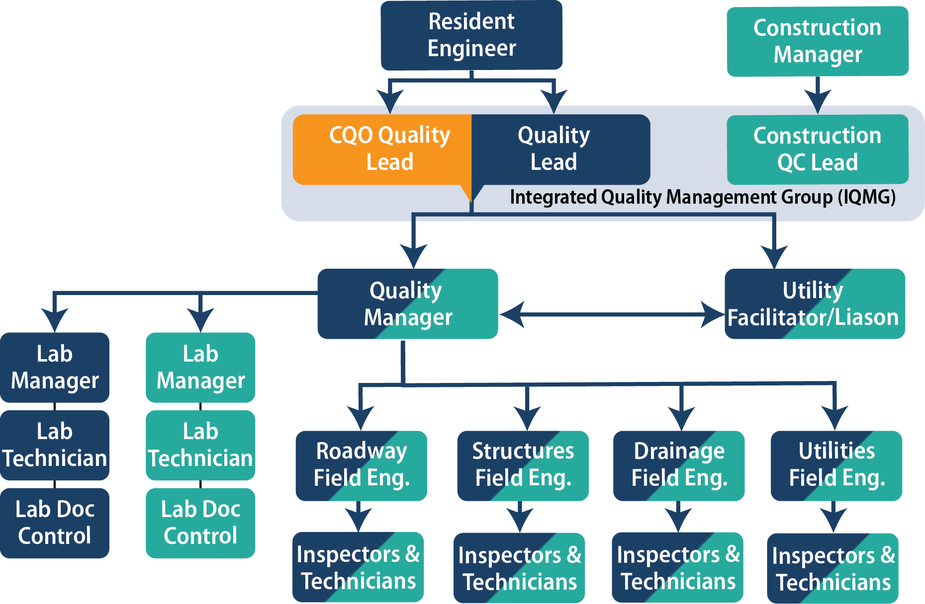
Composite Quality Organization
Blended team of owner and contractor quality staff
Uses one quality system for workflow, documentation, & analytics
Scalable allocation of staff, but allows owner-independent acceptance
Notes:
UDOT, program management, and PDB team collaborated on choosing a construction quality program and it was the consensus of the group that we chose a composite quality organization, where we combine the contractor’s test/inspections along with the owner’s test/inspections for the acceptance decision
Talk to slide Bullets:
o Blended Team
o One Quality System chosen by the combined team
o UDOT felt that a maximum of 75% of the testing and inspection would be completed by the Contractors Team and a minimum of 25% of testing and inspection would be completed by the Owner’s/Program Management Team and combined for the acceptance decision. The owner is 100% in charge of making the acceptance decision on all work.
One a side note the negotiated construction price allowed us to set the appropriate budget for the Composite Quality Organization.

Slide 36
Results in Application
Successes
Integration of blended team
Maintaining collaboration among the team
Close out occurs monthly
Work in Progress
Tracking & verifying quantities for shared risk/provisionals
Hiccups with the CIMS app
Managing long and short-term punch list items
Missing control points
Notes:
Successes:
o Blended Team requires a little more attention to make sure everyone is on the same page and pulling in the same direction.
o Need to make sure the lines of communication are open at all times, and that your escalation ladder is working to make sure the blended team is communicating. Collaboration/Communication is Key
o We close out work items on each pay app, so that there are minimal, outstanding issues at the end of the project. If we pay a work item at 100%, that means that all testing, inspections, materials certifications and control points are documented in the project folder
Work in Progress
o This contract was not entirely lump sum, we did include several provisional items and shared risk items in order to agree on a contract price. These items, such as temporary precast concrete barrier, need to be counted and are paid on a unit price basis, this is an ongoing challenge to agree on quantities.
o We are still experiencing a hiccup or two with our quality system
o Managing PL items to ensure we are not “covering up” non-conforming work.
o Missing control points (our metric for inspection %) is an ongoing issue that we need to stay on top of.

Slide 37
More Information
Project details and UDOT’s PDB process
UDOT's US-89 PDB
DBIA’s primer on PDB
PDB Primer
Notes:
Make note of this slide for a few second on where to find more information or answer other questions you may have on the process
Move to team slide and then open up for questions from there

Slide 38
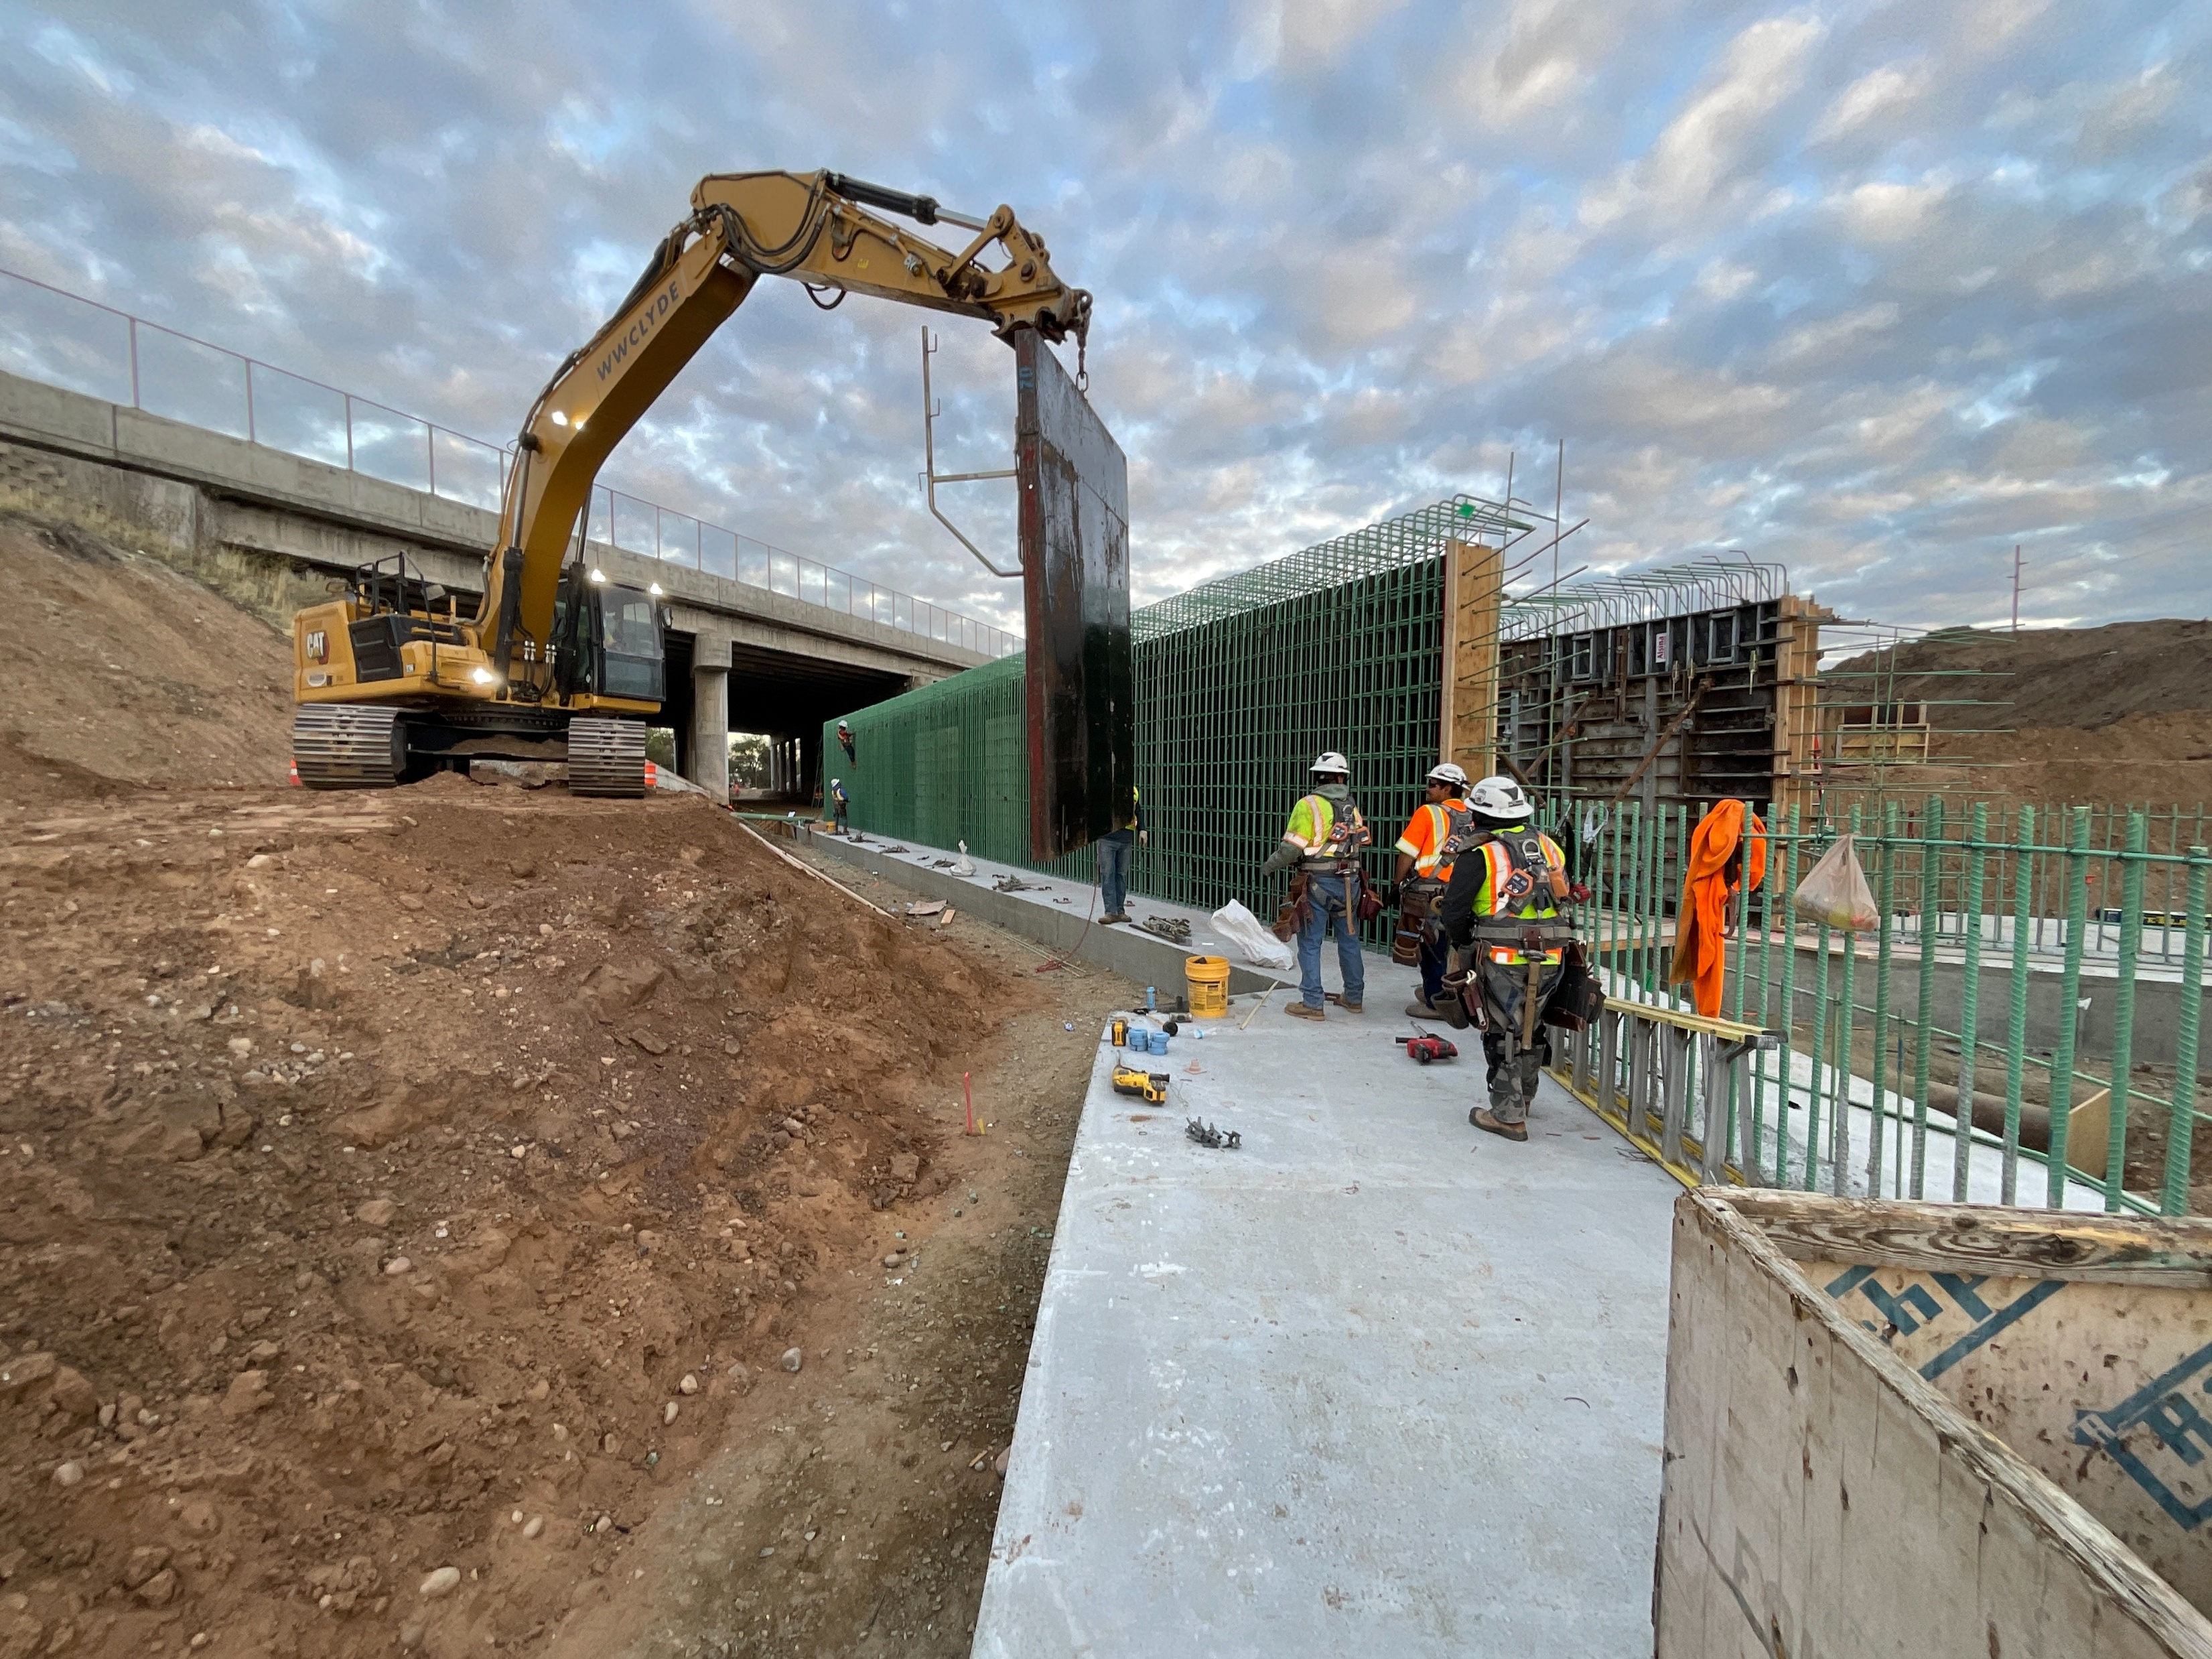
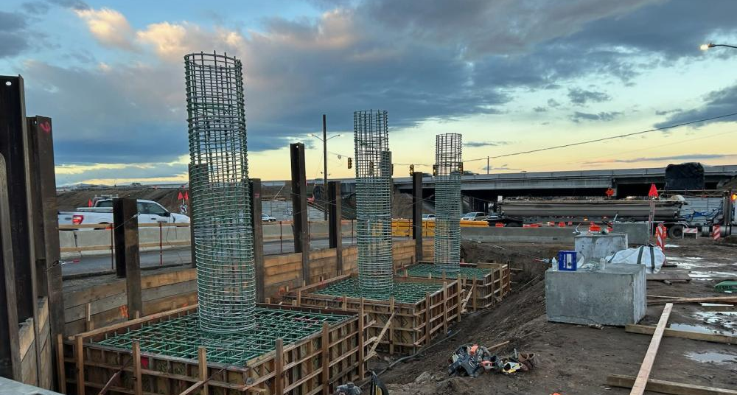
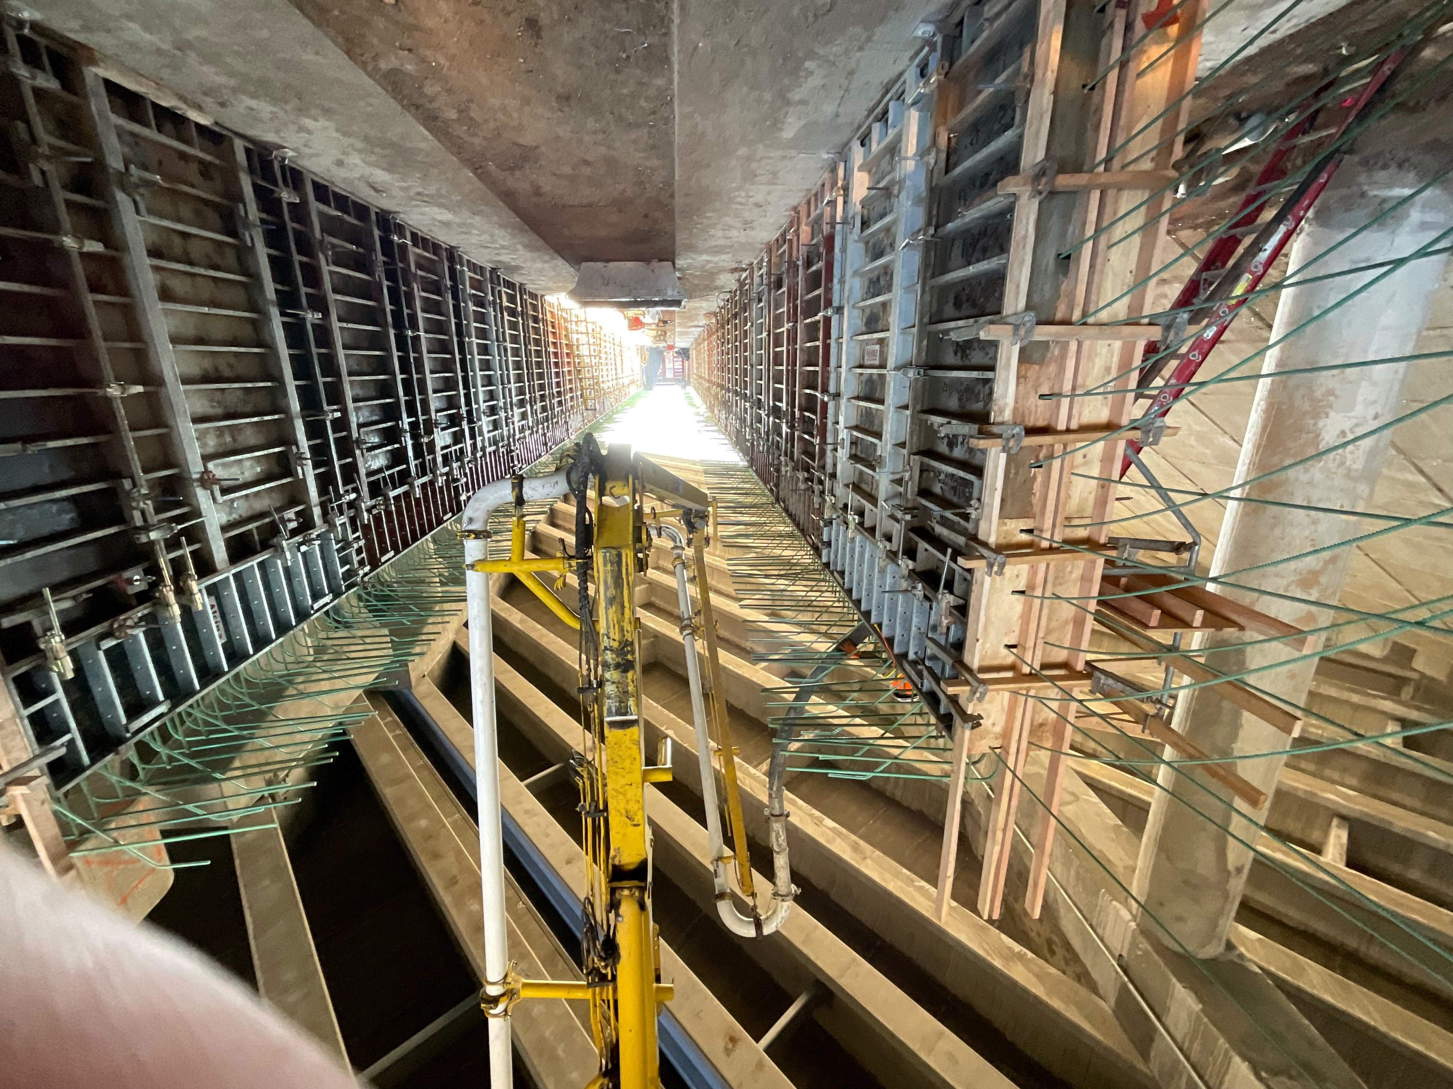
5600 SOUTH PDB
$360M
PDB ADVANTAGES:
UPRR rail corridor coordination
Adjacent project coordination
Third-party coordination
Hill Air Force Base coordination
Innovative foundation solutions
Flexibility within funding and timing constraints

Slide 39
ADDITIONAL PDB PROJECTS
I-15; 900 South Barrier, Wall, Slab, Junction Box Repair; Utah Department of Transportation | $300K
Bridal Veil Falls Improvement; Utah County, Utah | $10M
Confluence Parkway PDB; Wenatchee, Washington | $180M
4700 South Bangerter Highway Interchange; Salt Lake County, Utah | $180M
Notes:
I-15; SR-97 (5600 South), widening
Reno Spaghetti Bowl Xpress
4700
Bridal Veil Trail
Confluence Parkway
I-15; 900 South Progressive Design Build

Slide 40

Relevant Experience
$1B
PDB Projects
Completed
$1.5B
DB Projects Completed/In Progress
$1B
Active PDB Projects
$2.1B
DB Program Management Projects

Slide 41


